Slide 1
Searching for words outside
Let’s explore prehistoric times outside

Slide 2
WHAT?
outdoor adventure activity
on the topic of prehistoric times

Slide 3
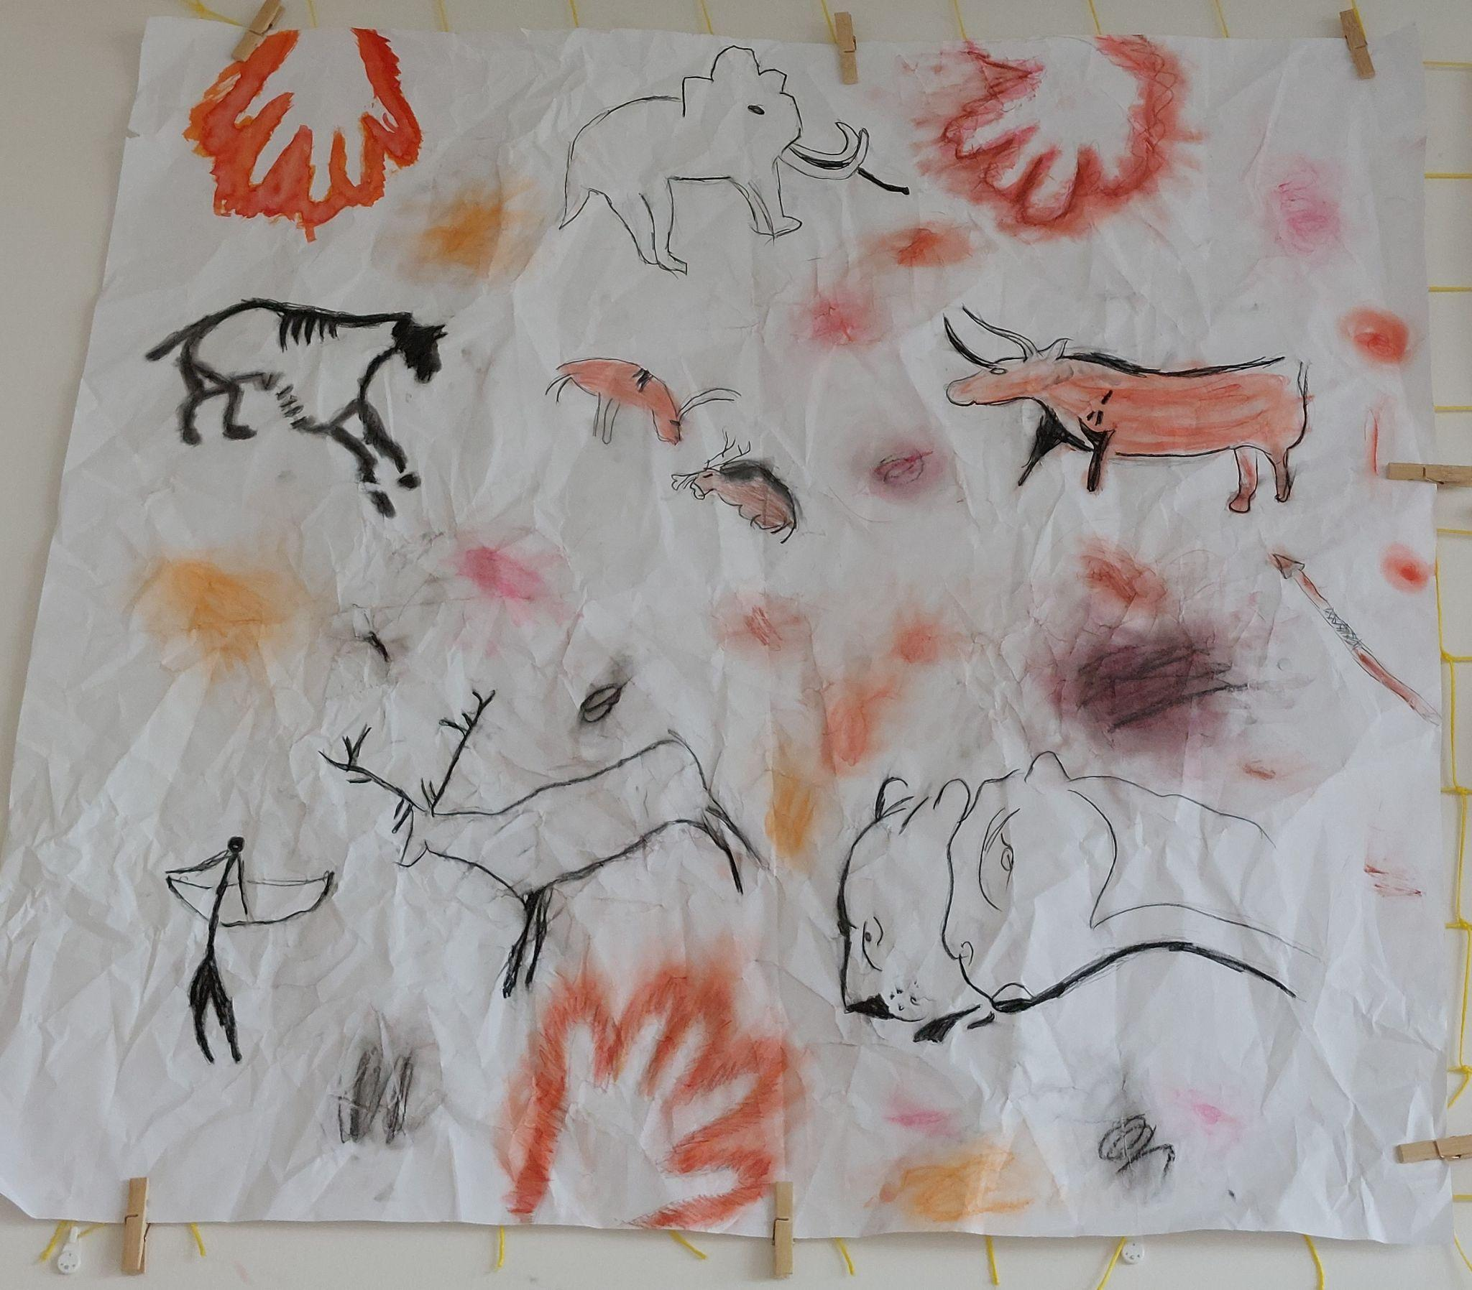
WHY?
repeating and expanding the curriculum on prehistoric period
strengthening reading comprehension skills
development of physical skills coordination and orientation skills
providing space for cooperation

Slide 4
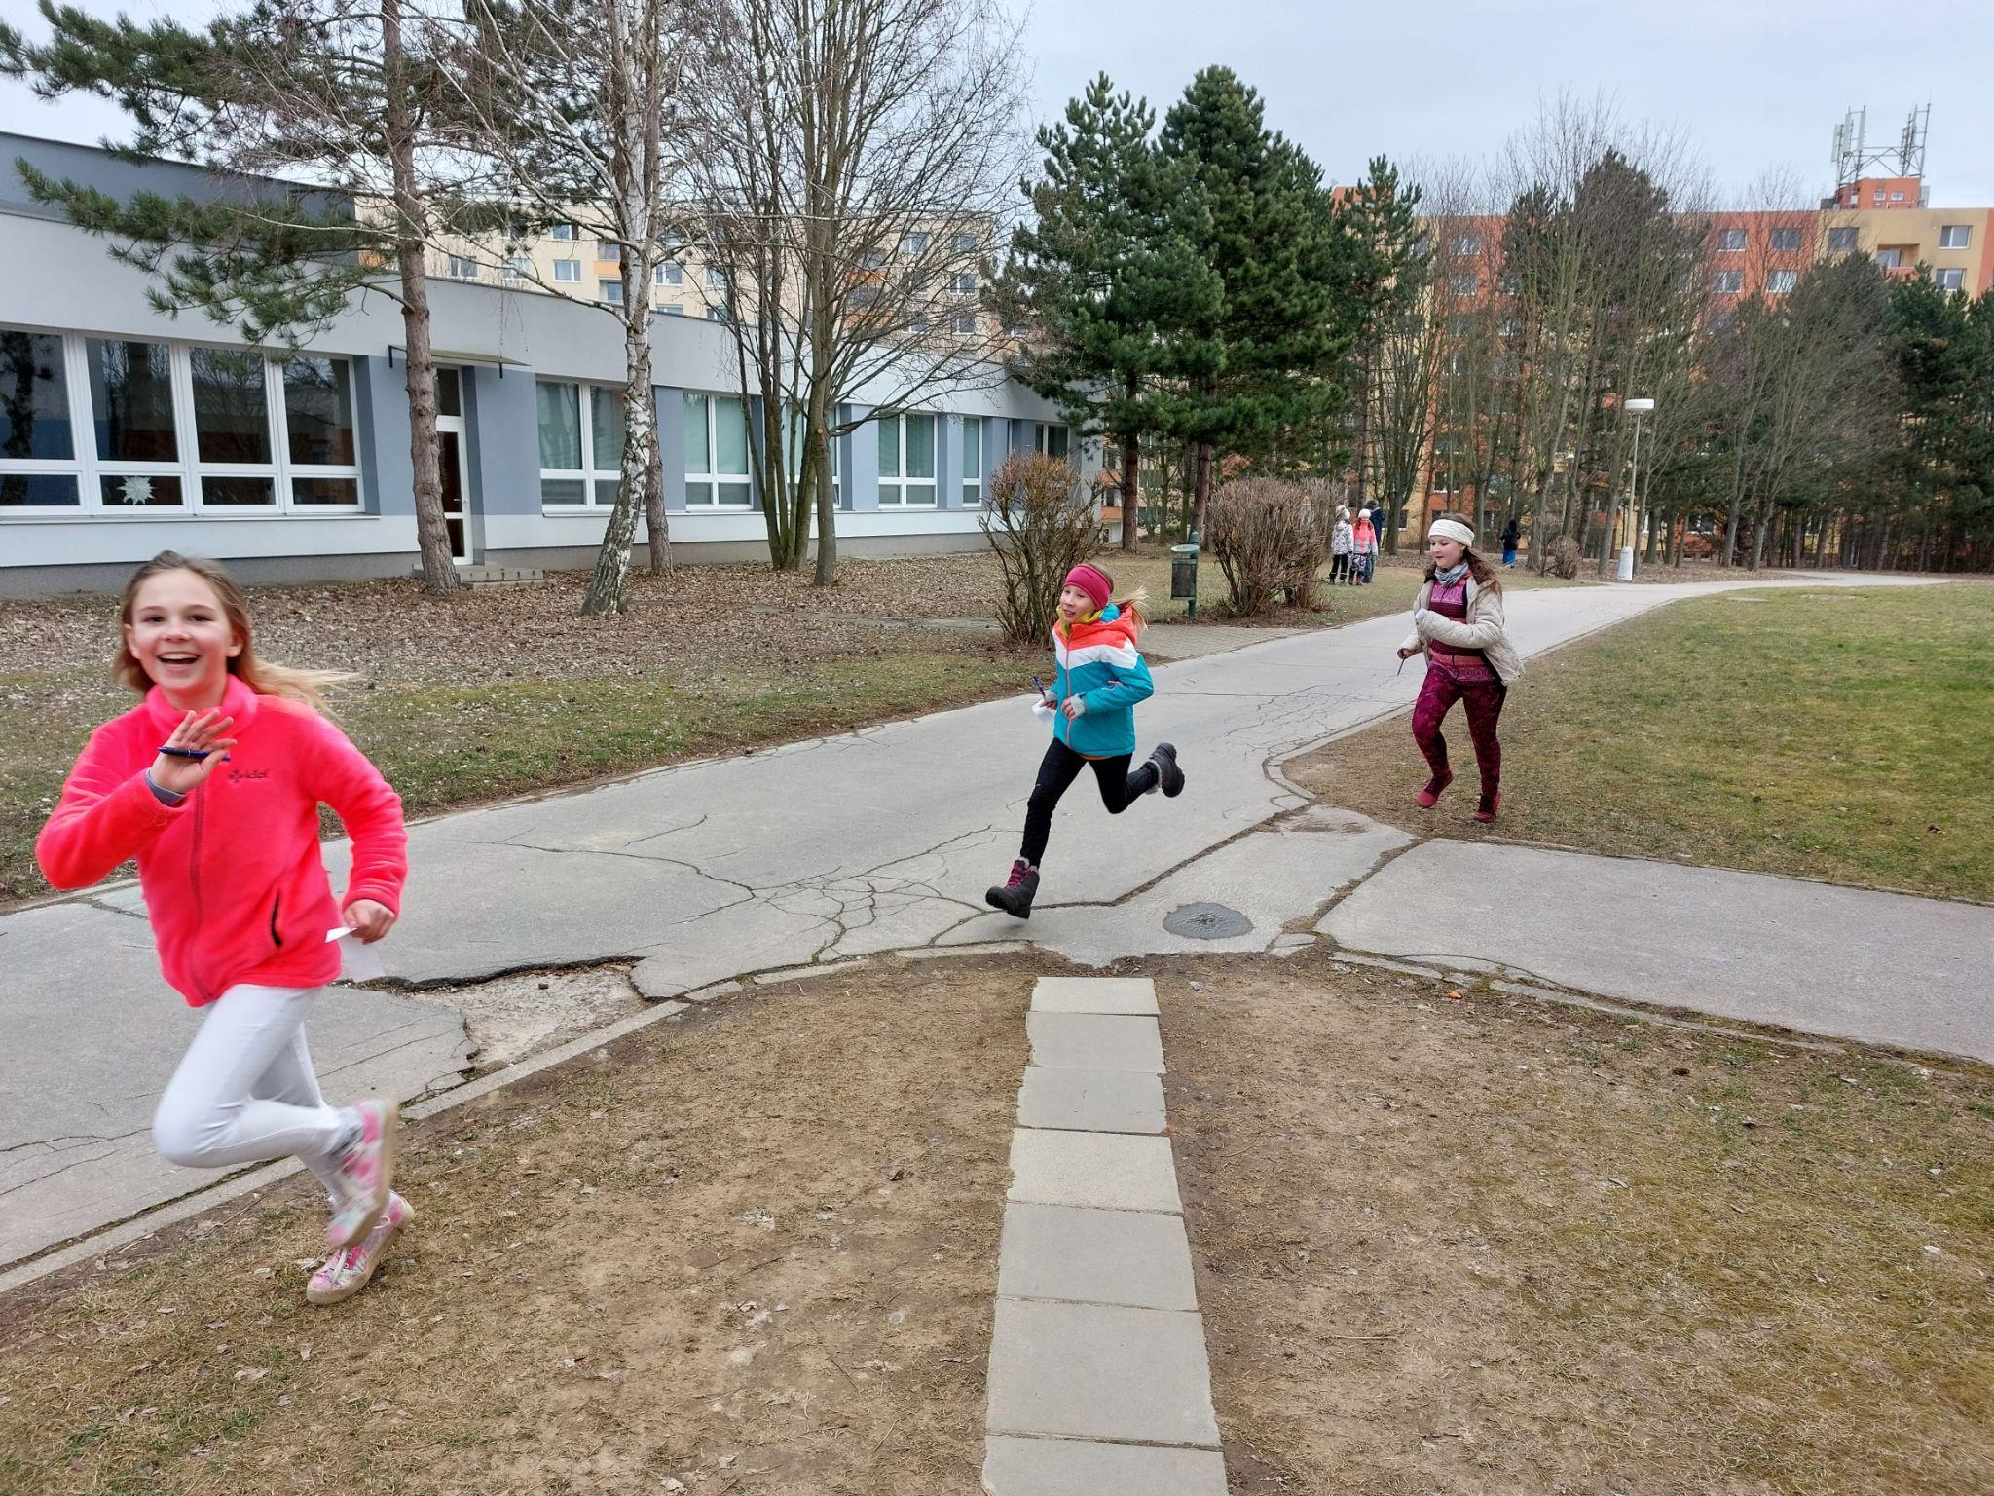
WHO?
fourth graders
from 9 to 10
years old

Slide 5
HOW?
Before the game
prepare flashcards with pictures and questions
place them on trees, climbing frames and other objects in the school grounds
explain the rules of the game to the children and give everyone a playing card with 11 squares

Slide 6
HOW?
Children worked alone/in pairs/groups according to their own preference.
They looked for cards with questions and marked the letter they get based on their answer (the correct answer gave them the correct letter to the password).
They wrote correct answers on the playing card and tried to figure out the password.
Then they went to tell the teacher the password. If it was wrong, they read the question again and corrected the answer.
Finally, we met in an community circle, evaluated the game and summarized what we have learned.

Slide 7
EX
AM PLES

Slide 8
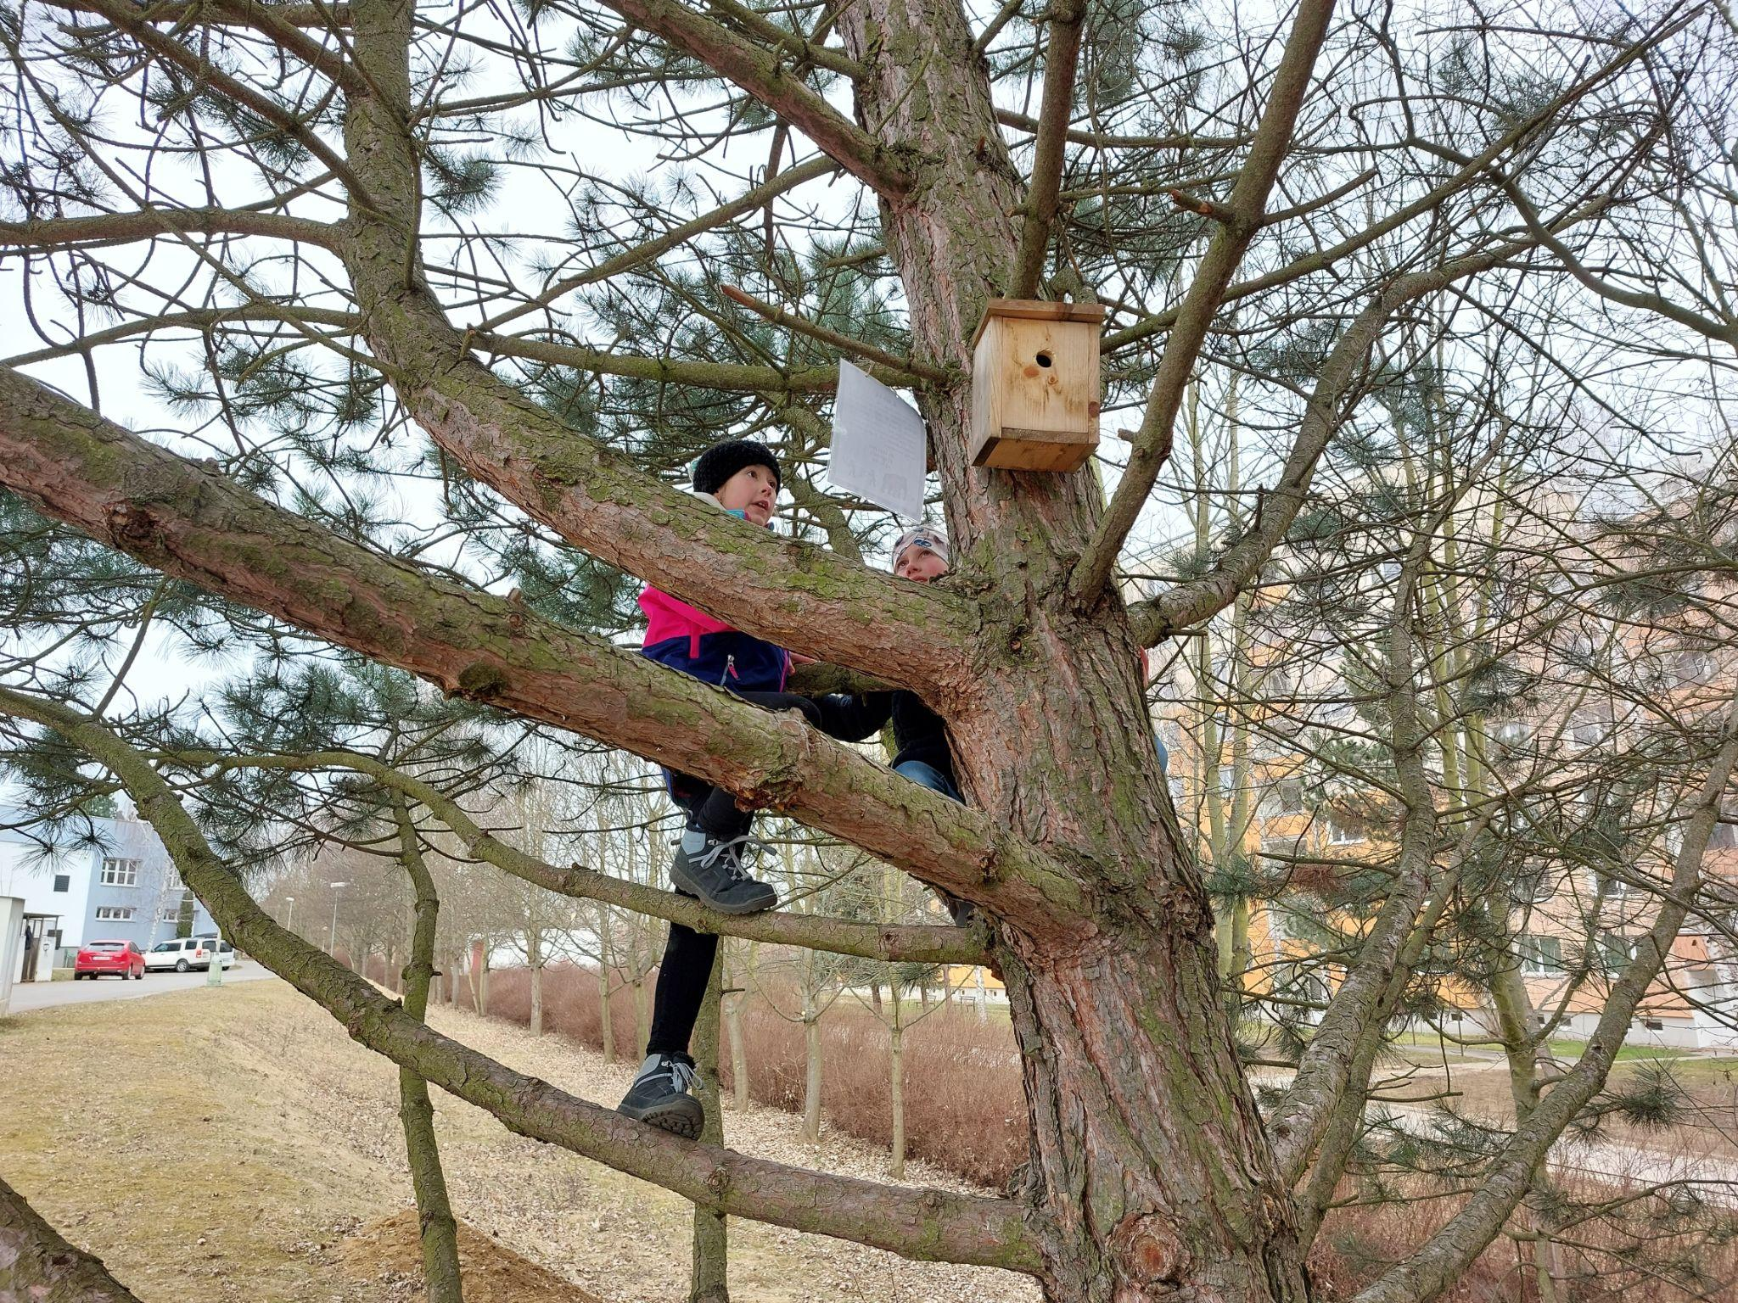
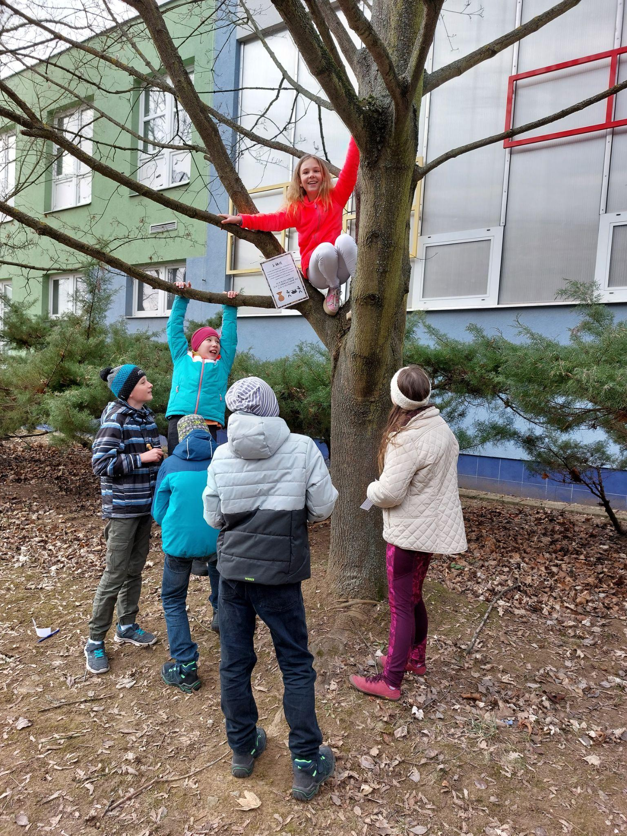
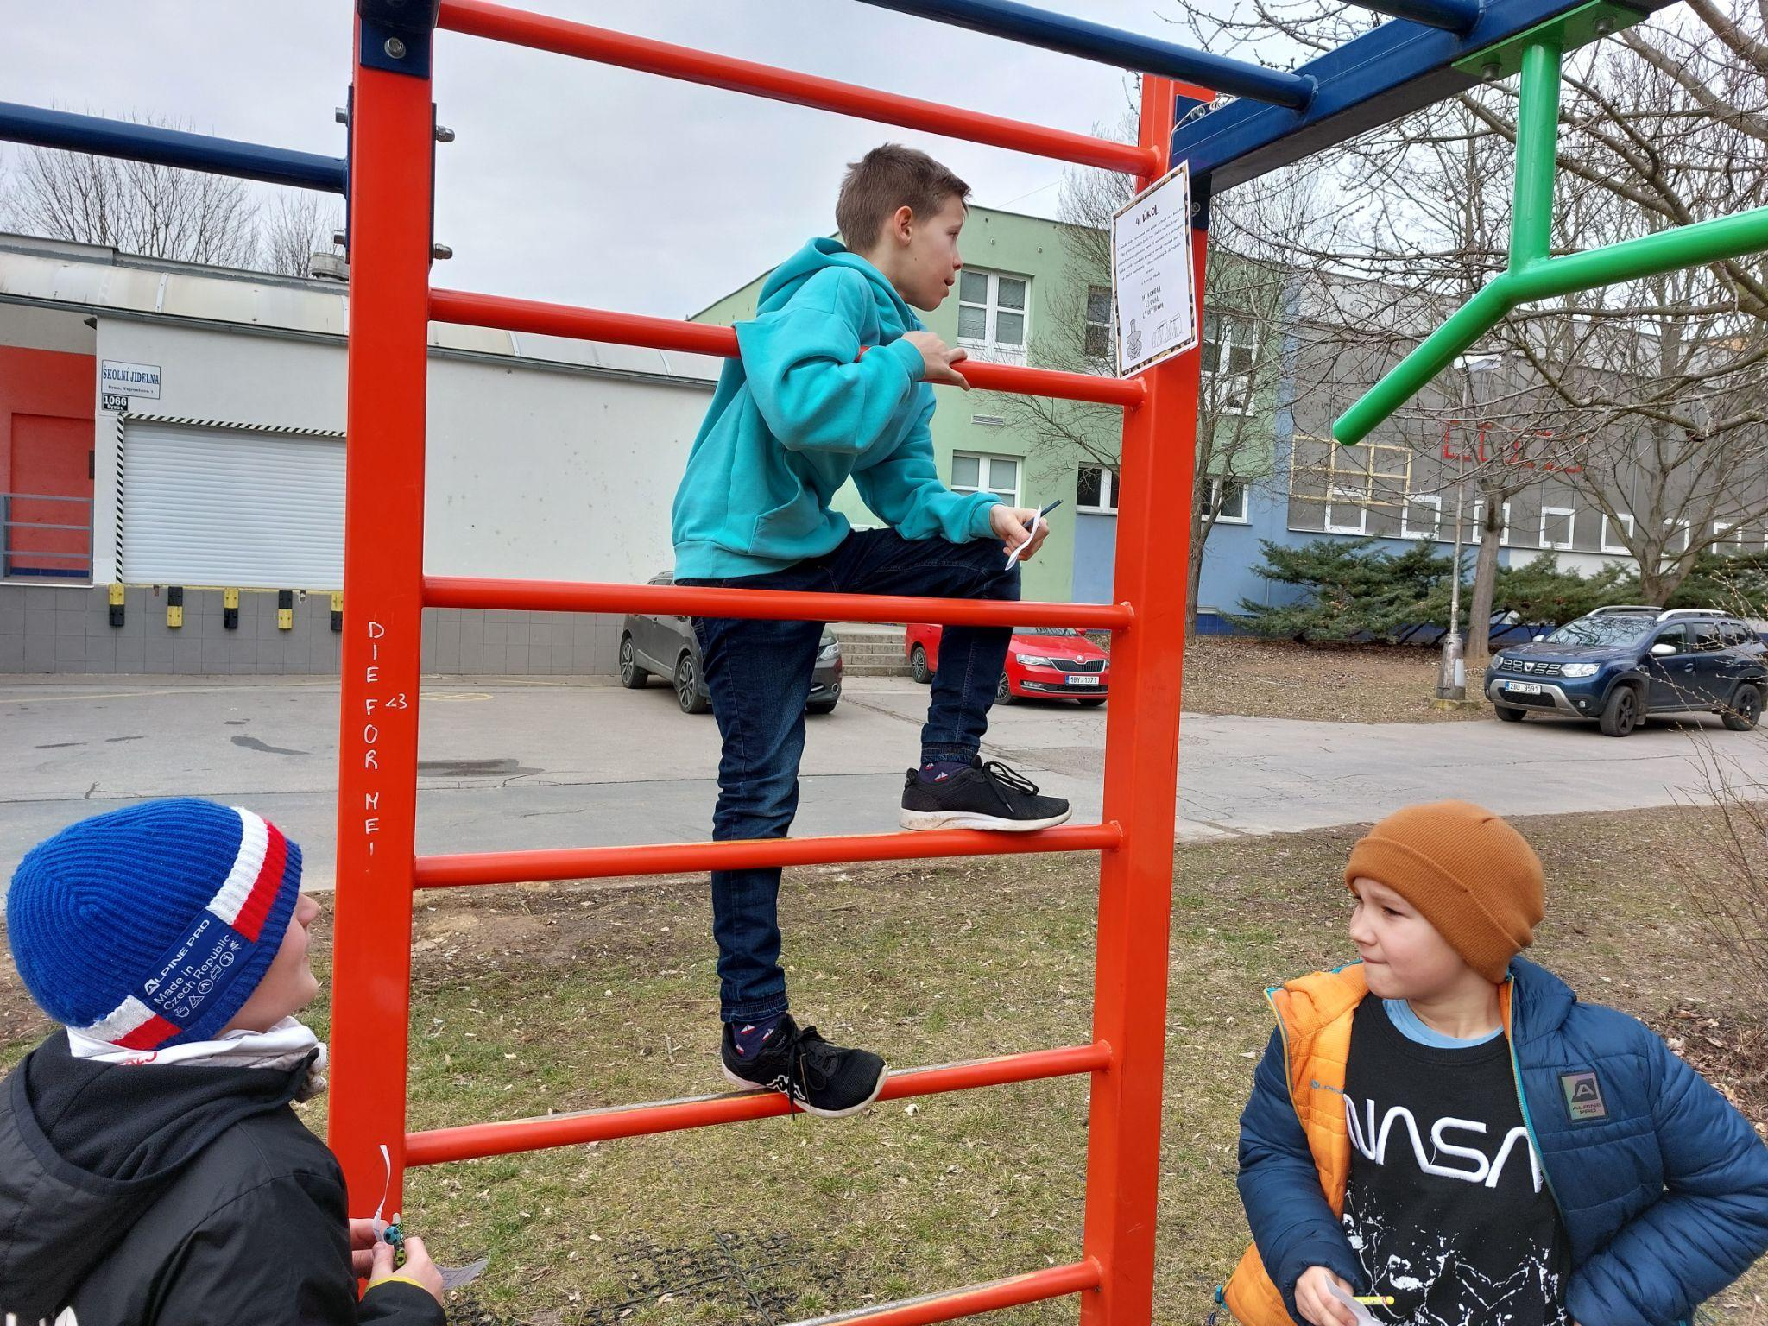
Searching for questions can be simple, without
much effort,
but also quite
adventurous.

Slide 9
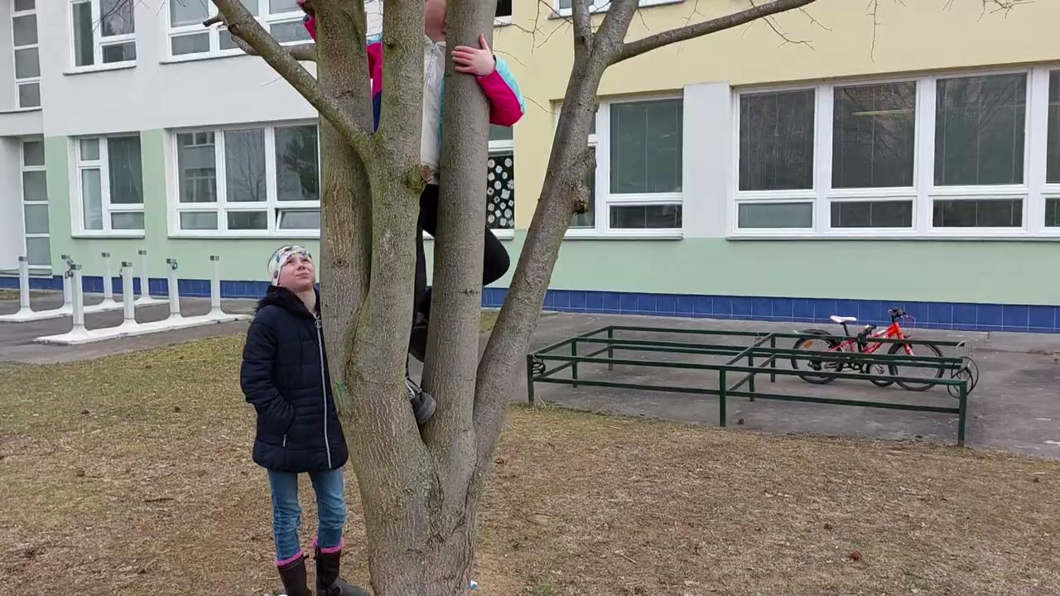
Children are working together, helping each other

Slide 10
RISKY AND PLAY?
Through outdoor play, pupils had a chance to explore the corners of the school grounds and places they had not been to before.
This gave them the opportunity to make decisions, measure their strengths and physical capabilities, and solve problems.
During the game, the children struggled with
great height
roughness and falls
dangerous places and elements
disappearing from sight

Slide 11
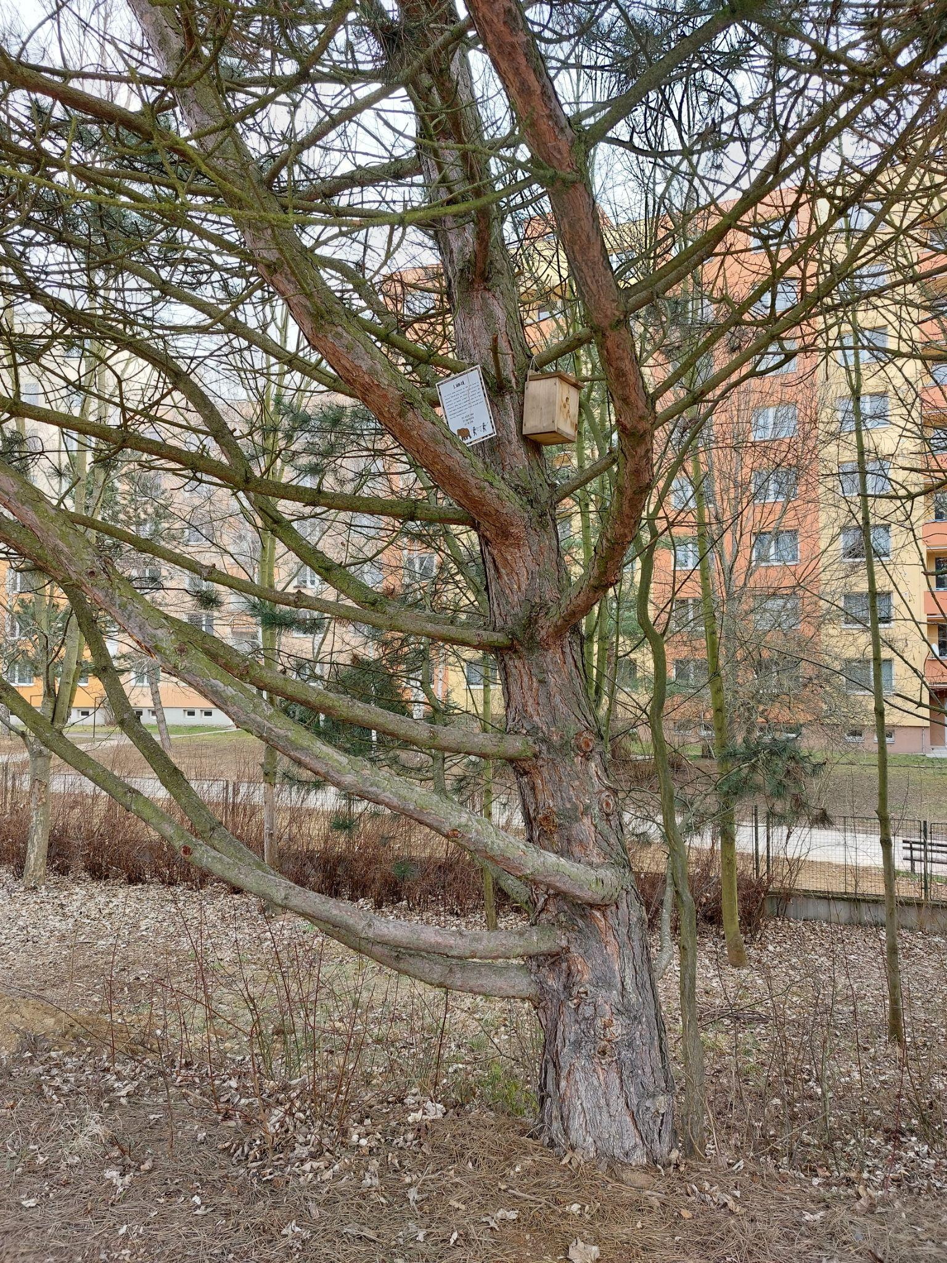
HOW WAS IT FOR ME AS A TEACHER?
Placing cards on trees was a challenge for me, I haven’t climbed trees for a long time. :-)
I enjoyed watching excited children running around the school grounds and playing the game to the fullest.
I made sure that any subject can become more attractive when the teaching is carried out outside.
I enjoyed preparing and implementing the game, my pupils appreciated it and that is the most important thing for me.

Slide 12
HOW WAS IT FOR THE PUPILS (MOTIVATION, GROUP DYNAMIC, FOCUS,...)?
The children were motivated, they are always interested in outdoor learning.
They were excited about climbing trees.
They rated the difficulty of the questions positively.
The atmosphere in the group was excellent. Children shared roles, cooperated and communicated.

Slide 13
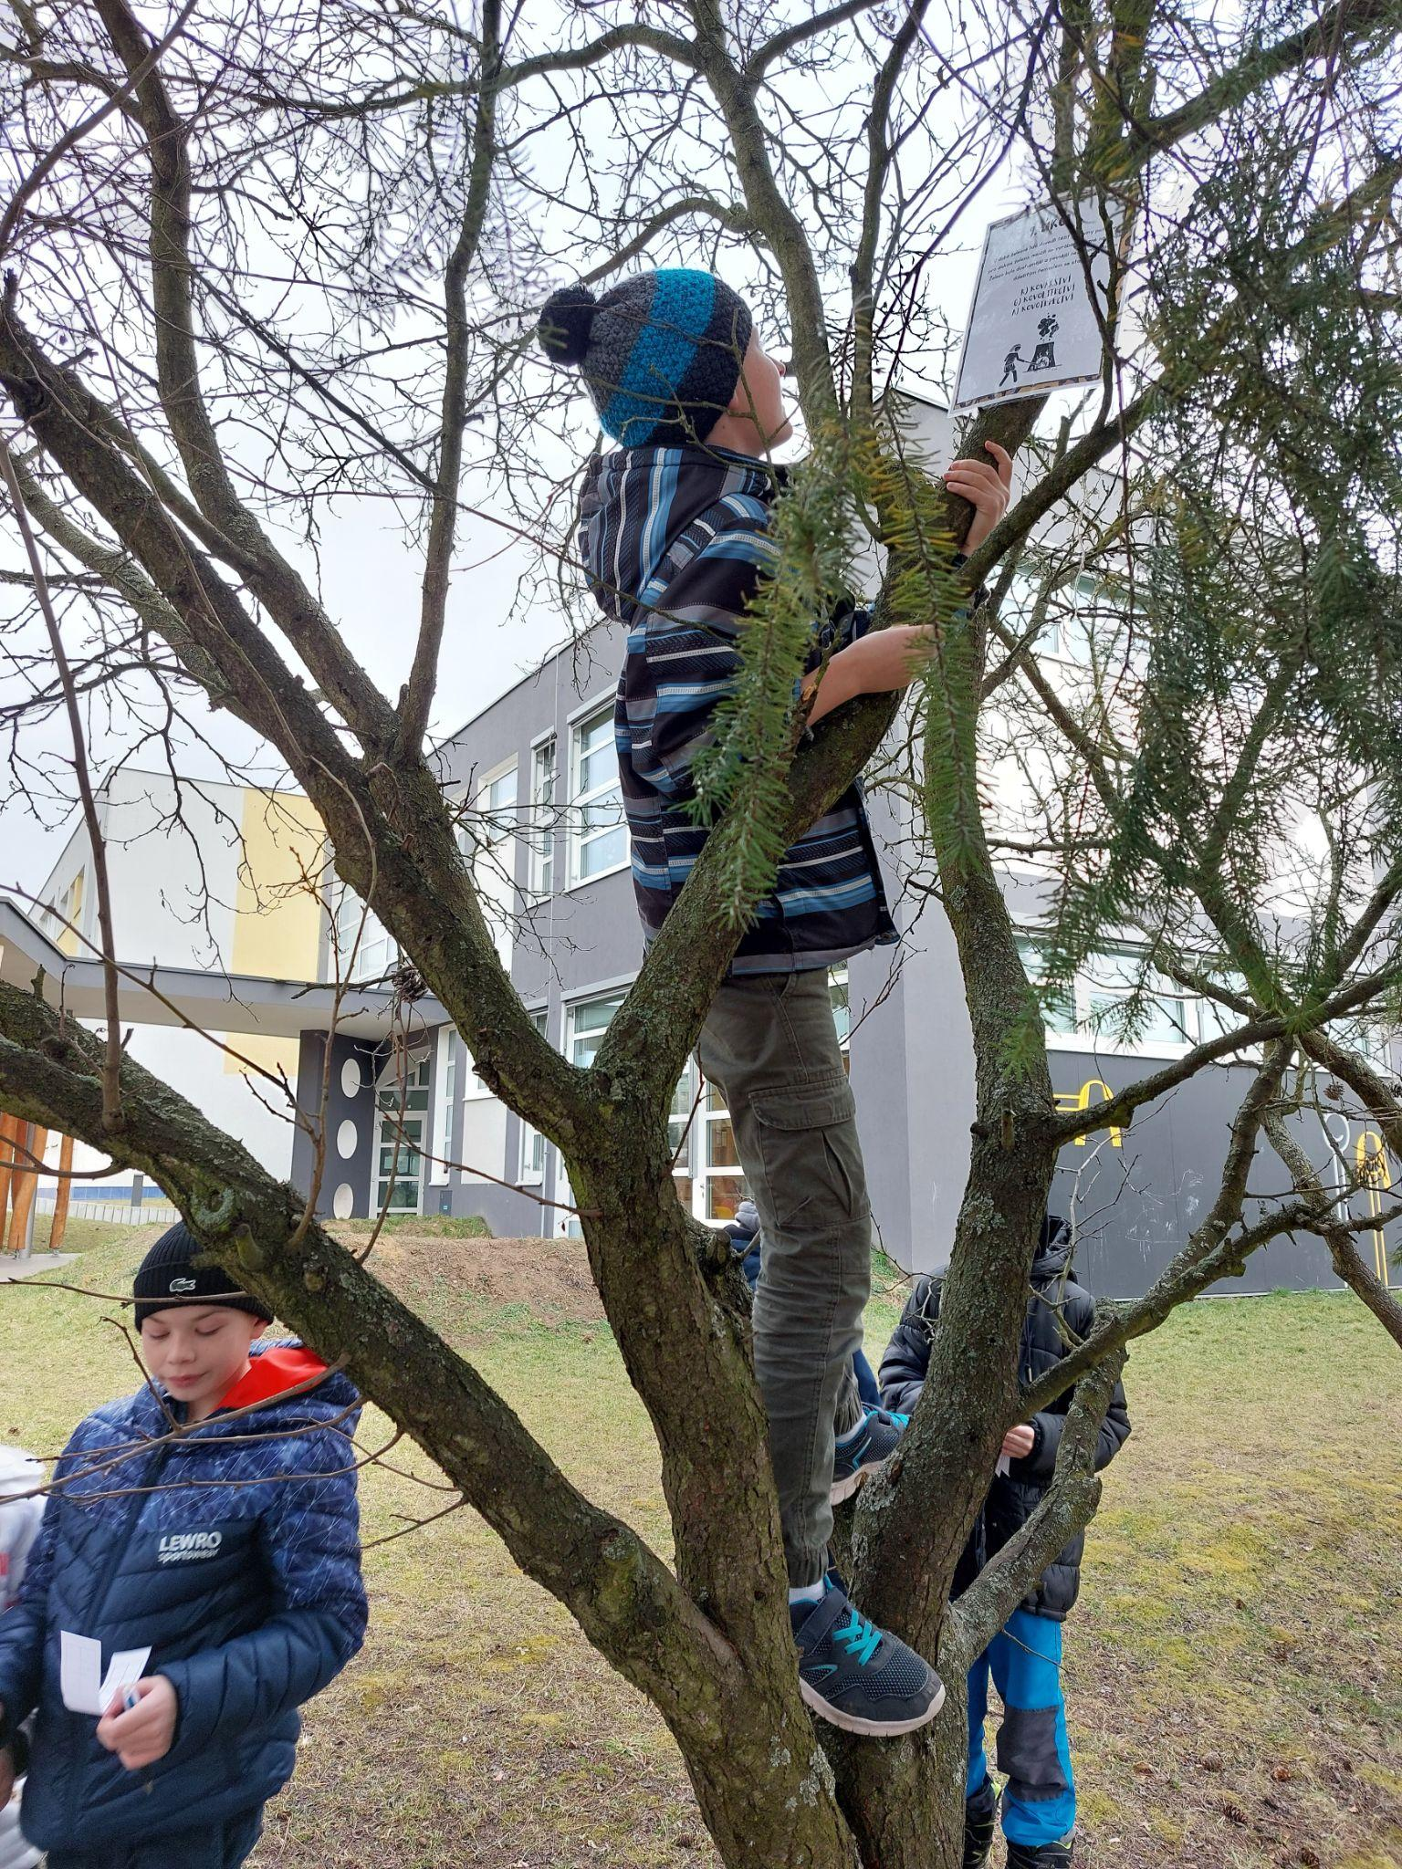
WHAT WORKED BEST/WHAT WOULD I ALTER?
During the game, the cooperation between the children worked perfectly, they supported and helped each other.
Most of the children were not afraid of climbing the trees and enjoyed it.
Next time I would dare to choose an even more difficult terrain.

Slide 14
CONDITIONS (MATERIALS, INFRASTRUCTURE, PREPARATION,...)
The game did not require any special equipment. I prepared and printed the texts, laminated them and attached them to outdoor objects with string.
The advantage is that the surroundings of our school are diverse.
The weather that day was very favorable.
Overall, the game was very successful and benefited the children.

Slide 15
Thank you for your attention.

