Slide 1
APOLE - Project
Riskful play

Slide 2
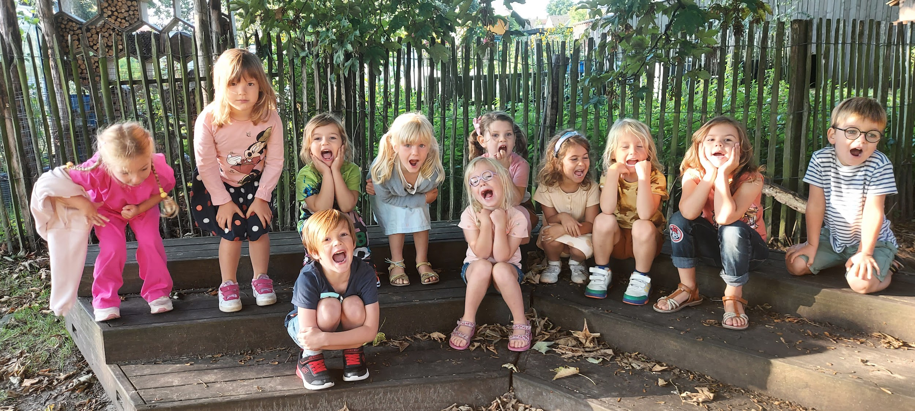
'yes we are in!'
call out the 5-year-olds, 3rd kindergarten class
class group of 24 preschoolers, split into 2 groups
Organisation
small group
be young
struggles with task orientation
independence
Notes:
At the start to the school year, i can only give this group limited freedoms. You observe the group dynamics and the group level before organisation.

Slide 3
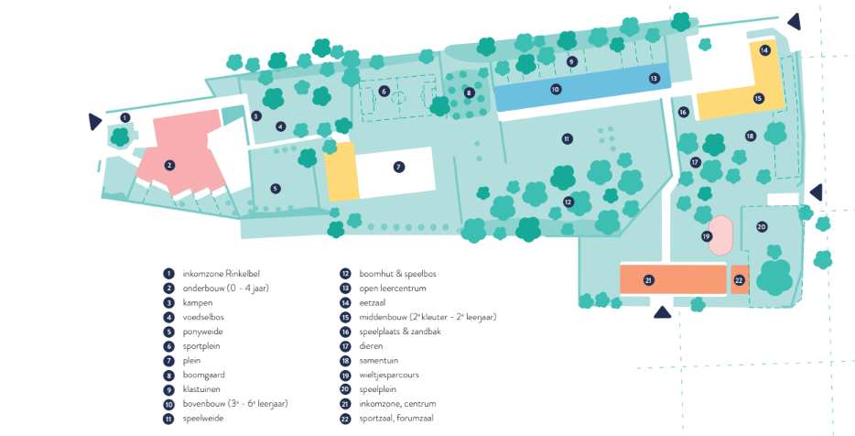
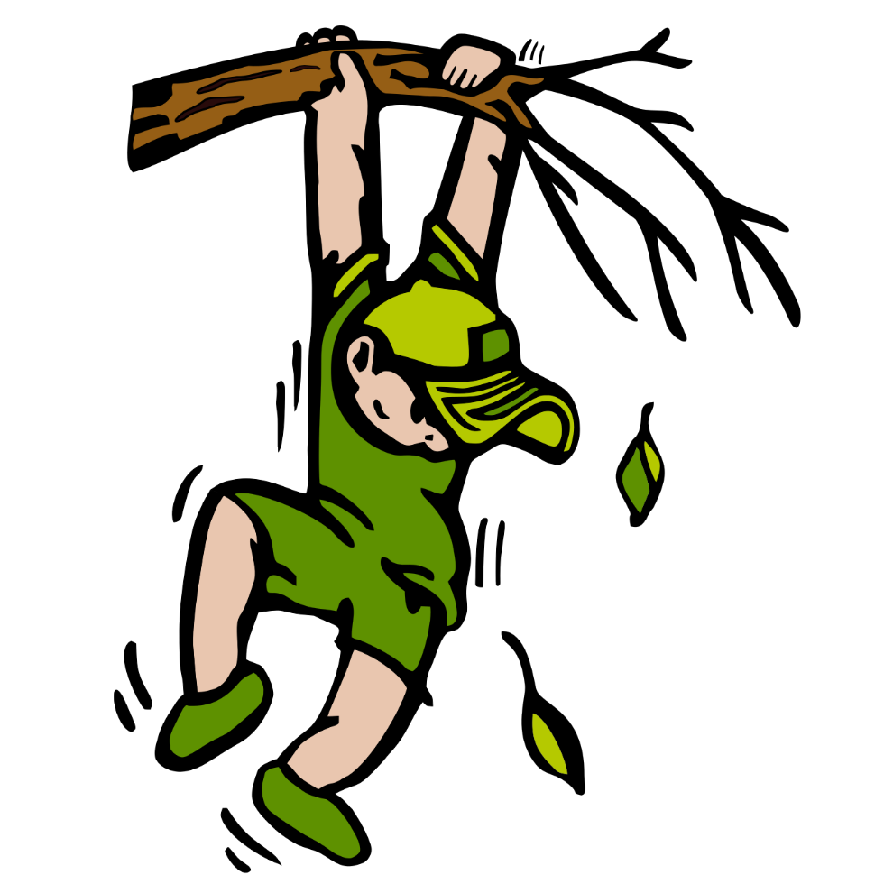
The playground is challenging for these young children, you will see this in the rest of the presentation.
Notes:
This is the environment where the quest was. The children must search there own way. I have to guide and tho slow down them so that they take the time to notice the indications.

Slide 4
ORIGINAL GOALS
intrinsic and extrinsic motivation
spatial insights
cooperative working / dialogue
solution-oriented thinking
ability to play / work safely with risk
respect for nature
active participation / challenge
Notes:
with younger children the emphasis is on more basic goals and with older children these are already self-evident

Slide 5
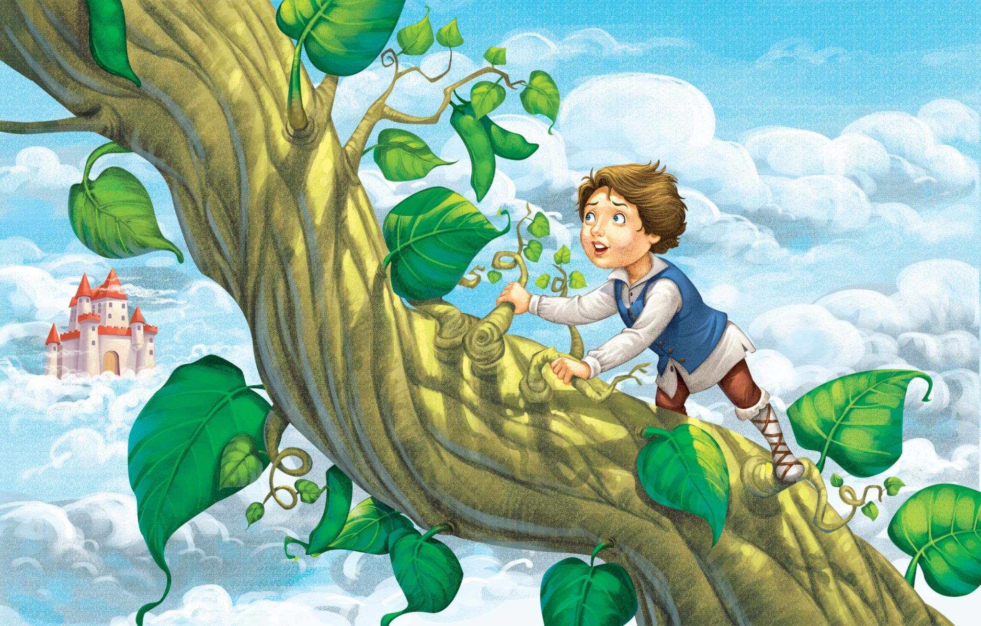
Intrinsic and extrinsic motivation
Puppet show: a variation on the story of Jack and the Beanstalk. The beanstalk consists of stepping stones (geometric shapes), the giant stole all the people's valuables after which the people destroyed the giant's ladder, from the clouds to their village.
Jack gets 1 stepping stone when he sells the cow, he asks for help, to find the other stepping stones in our domain.
Goal: Looking for the stepping stones that will help Jack up to the clouds to bring all the stolen valuables back to the village.
Notes:
I triggered the children with this story. I made a variant so ik can play the game with them.

Slide 6
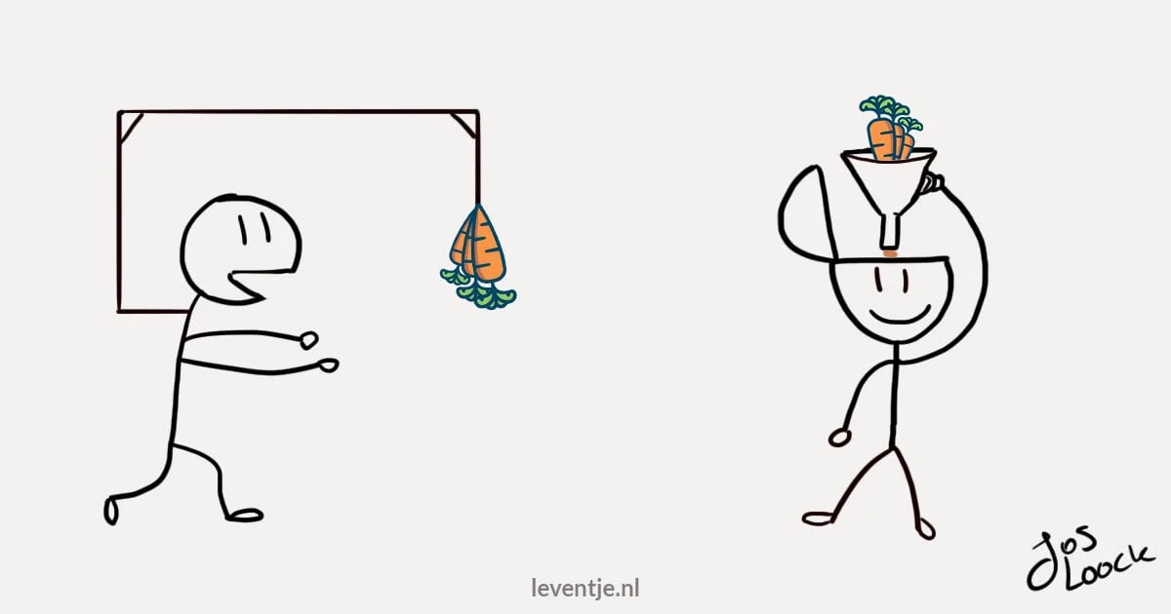
Intrinsic and extrinsic motivation
"Are you helping Jack? You guys know the Tandem better."
We go outside and find clues, arrows, ...
"Take your time and keep your eyes open."
Notes:
finding the step stones, that's the extrinsic motivation

Slide 7
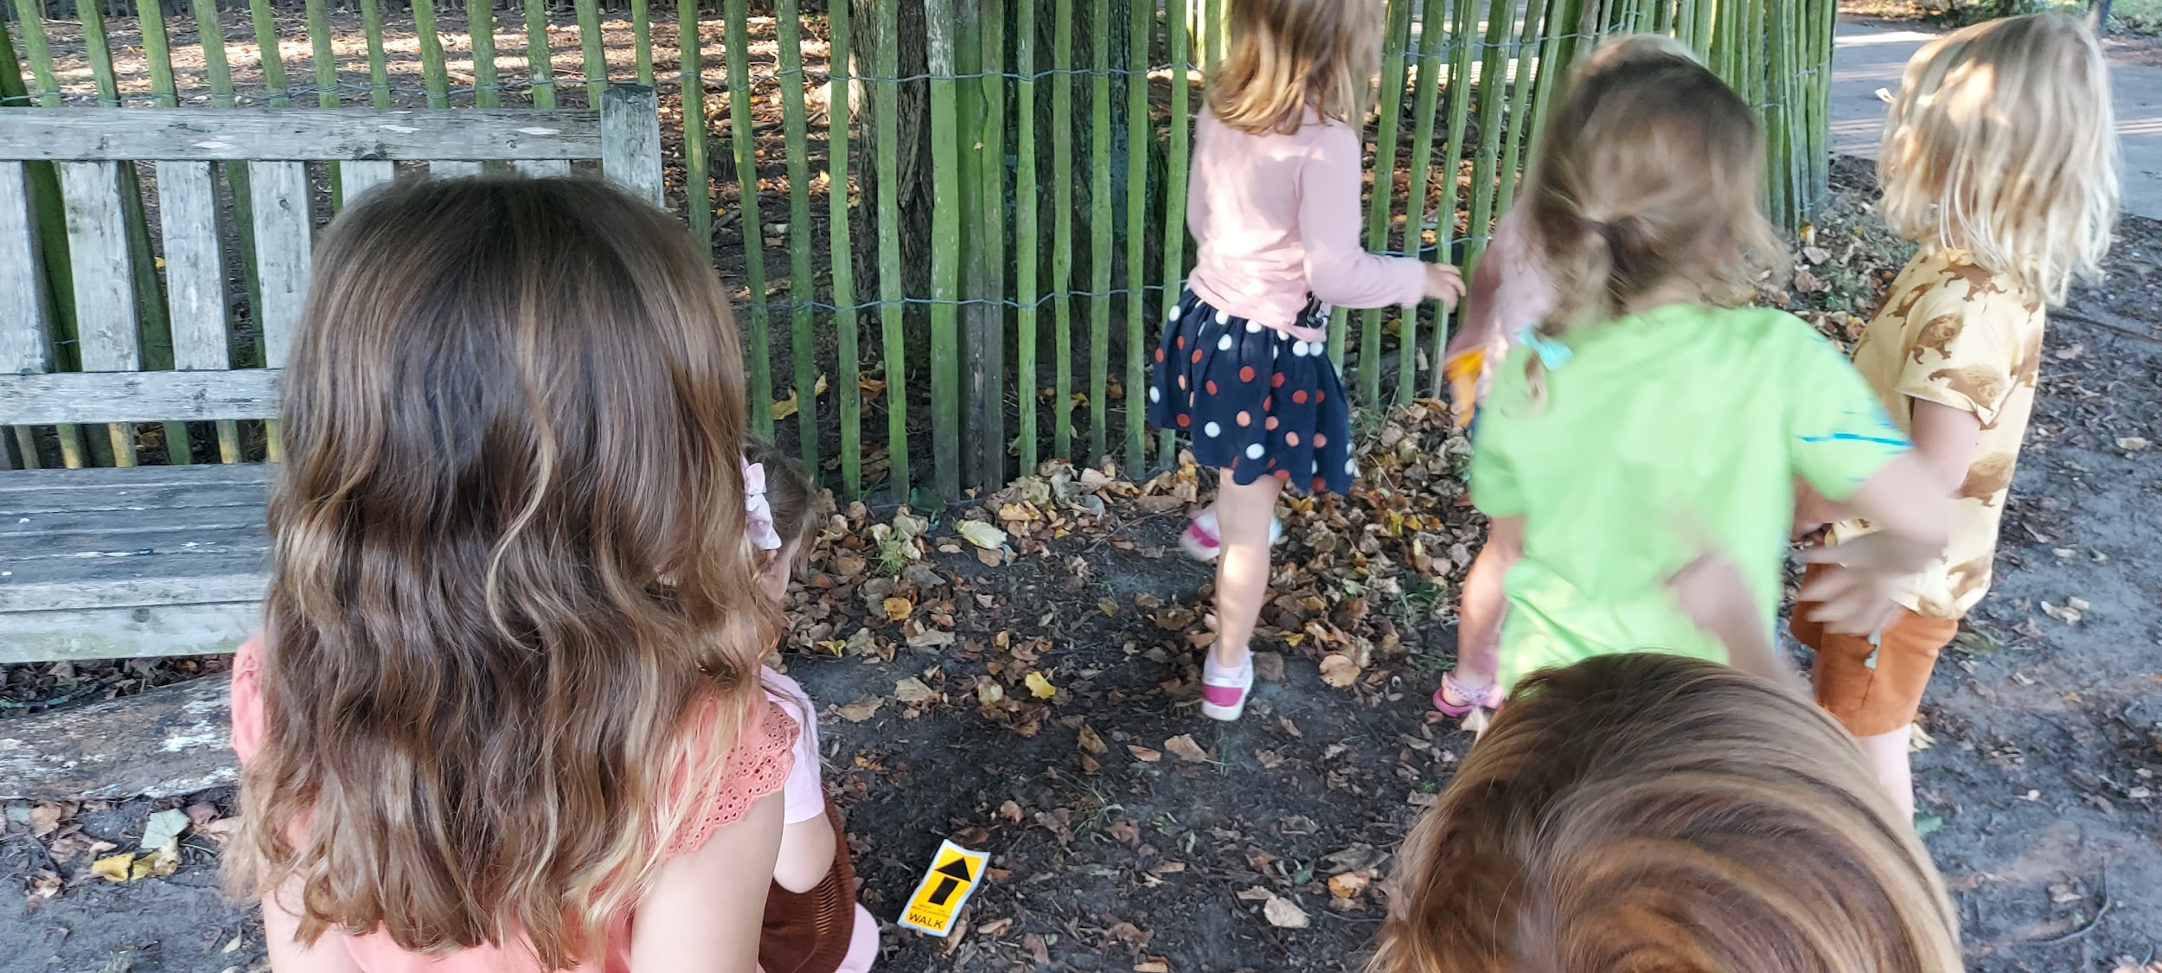
Spatial insights
‘We find the right way by following the arrows!’

Slide 8
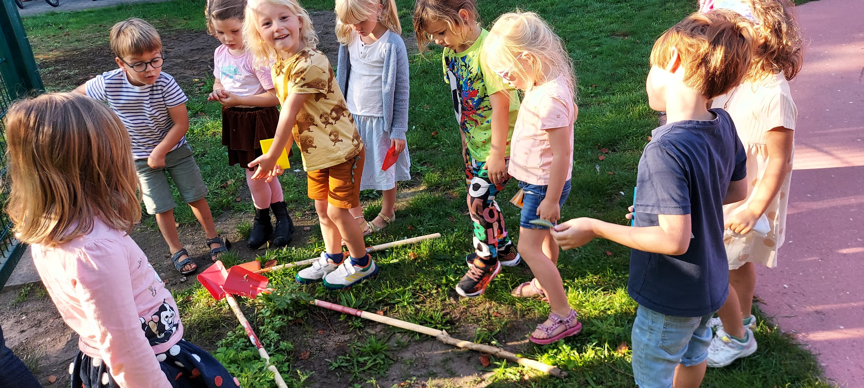
Spatial insights
Pointing in the right direction

Slide 9
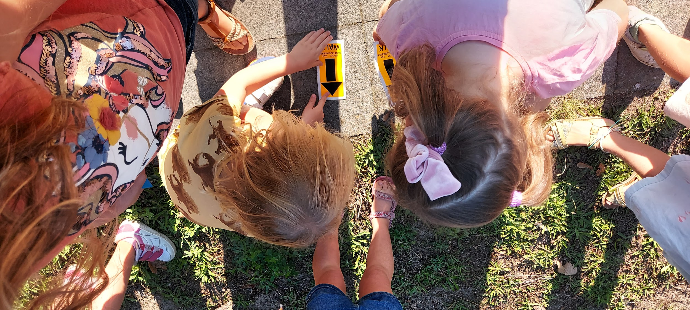
Spatial insights
The arrows tell us where to find the stepping stones

Slide 10
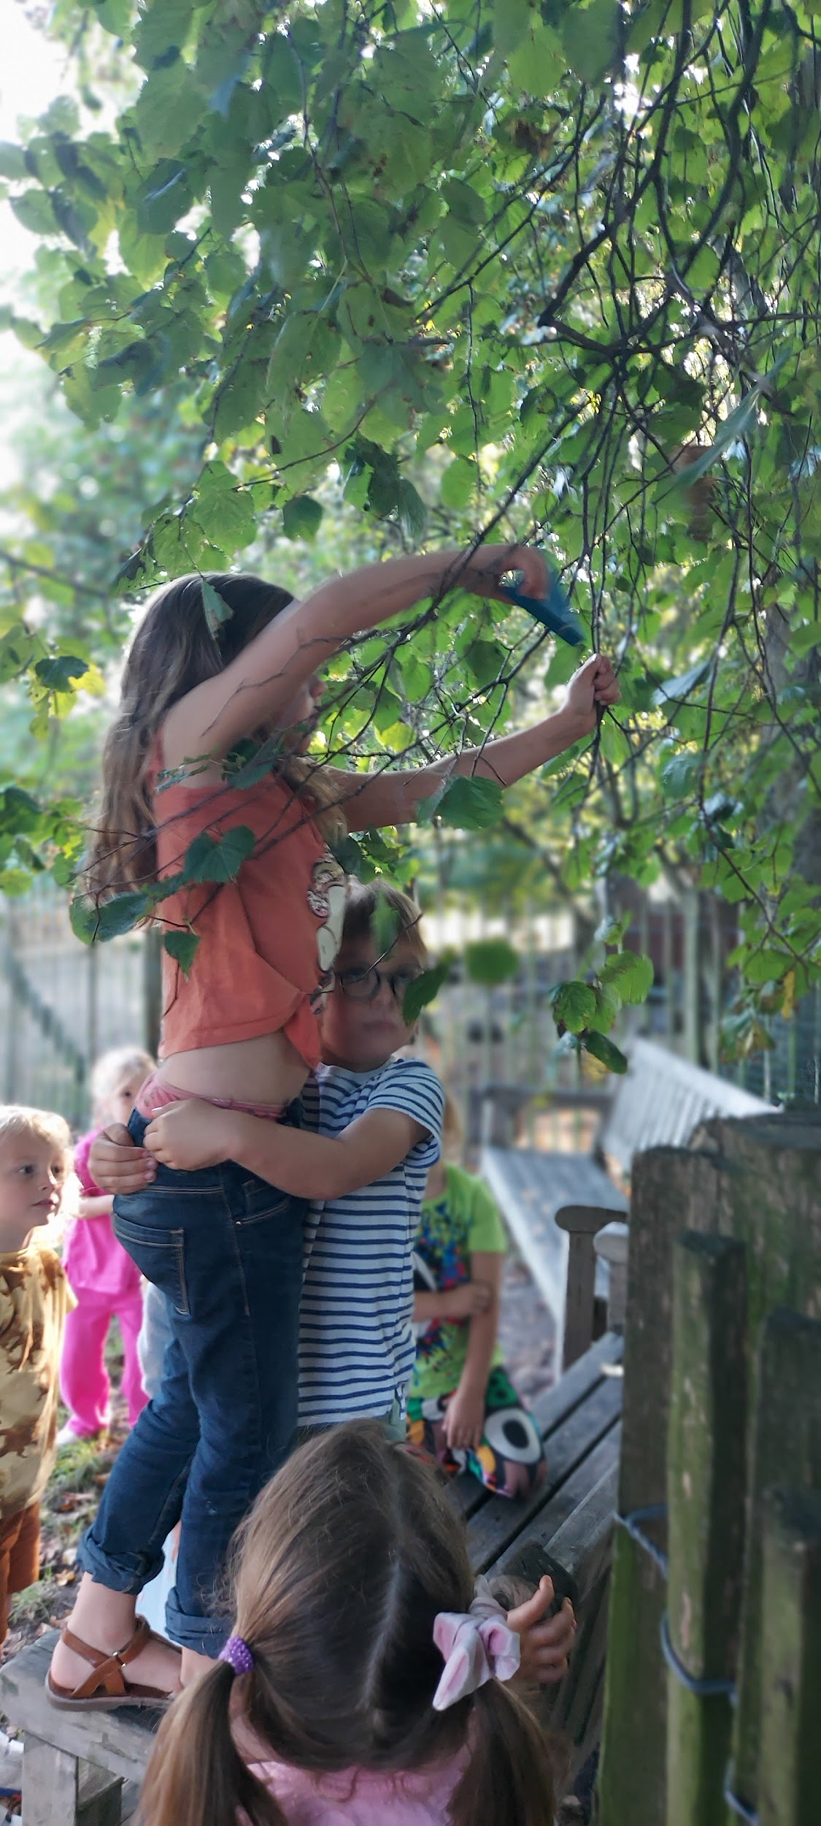
Cooperative working / dialogue
'I don’t dare climb the tree'
‘I will help you’

Slide 11
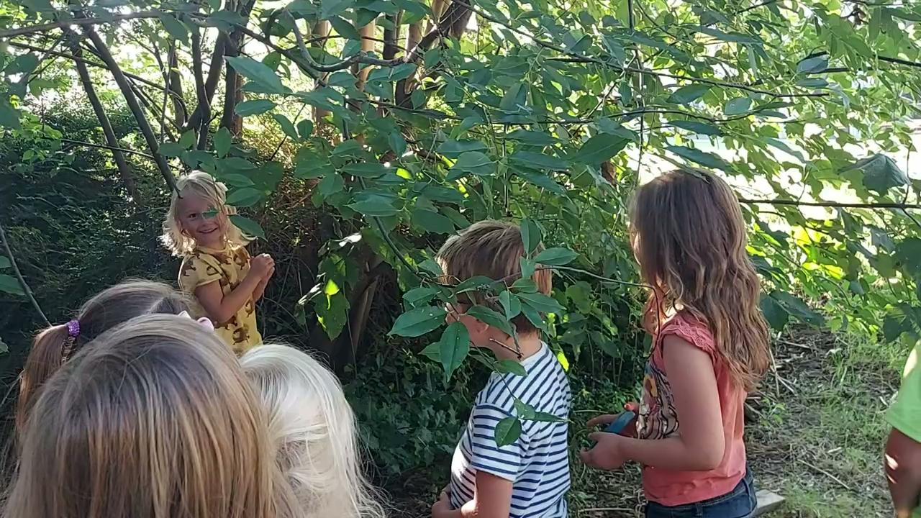
Cooperative working / dialogue
VIDEO
'I have a plan, look, it works with a branch too'

Slide 12
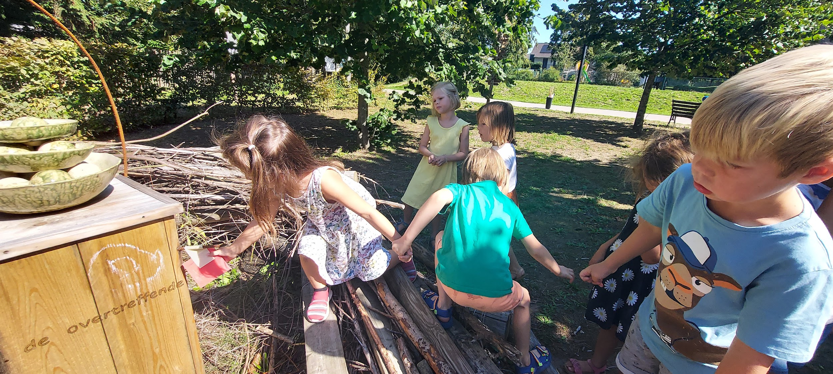
Cooperative working / dialogue

Slide 13
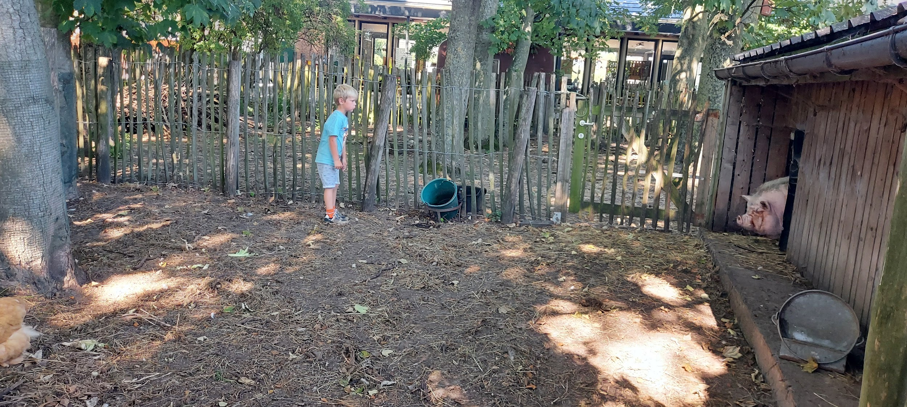
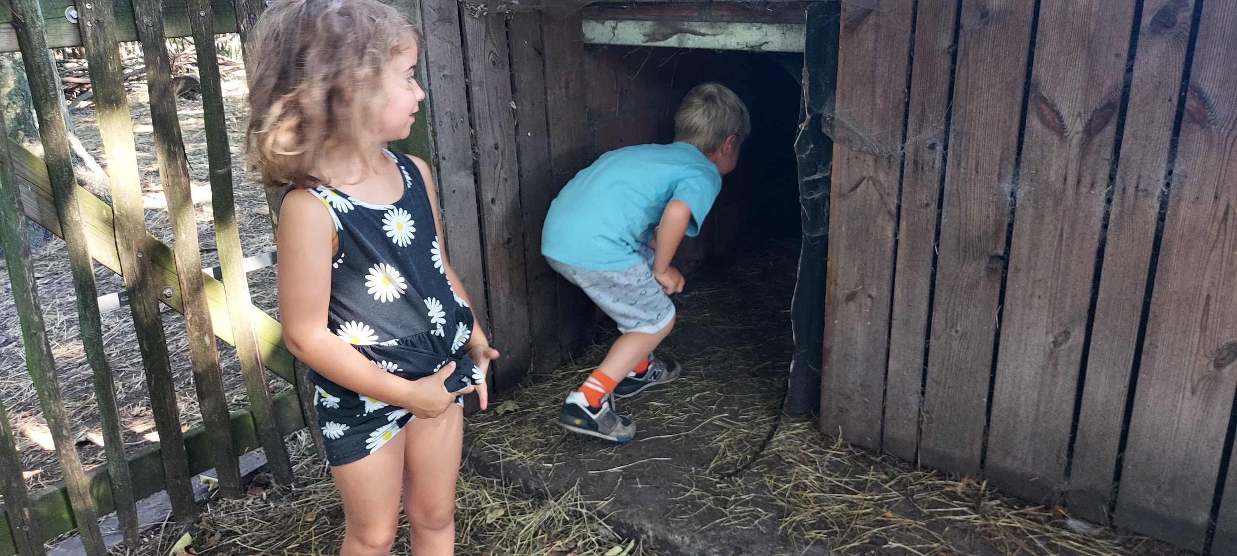
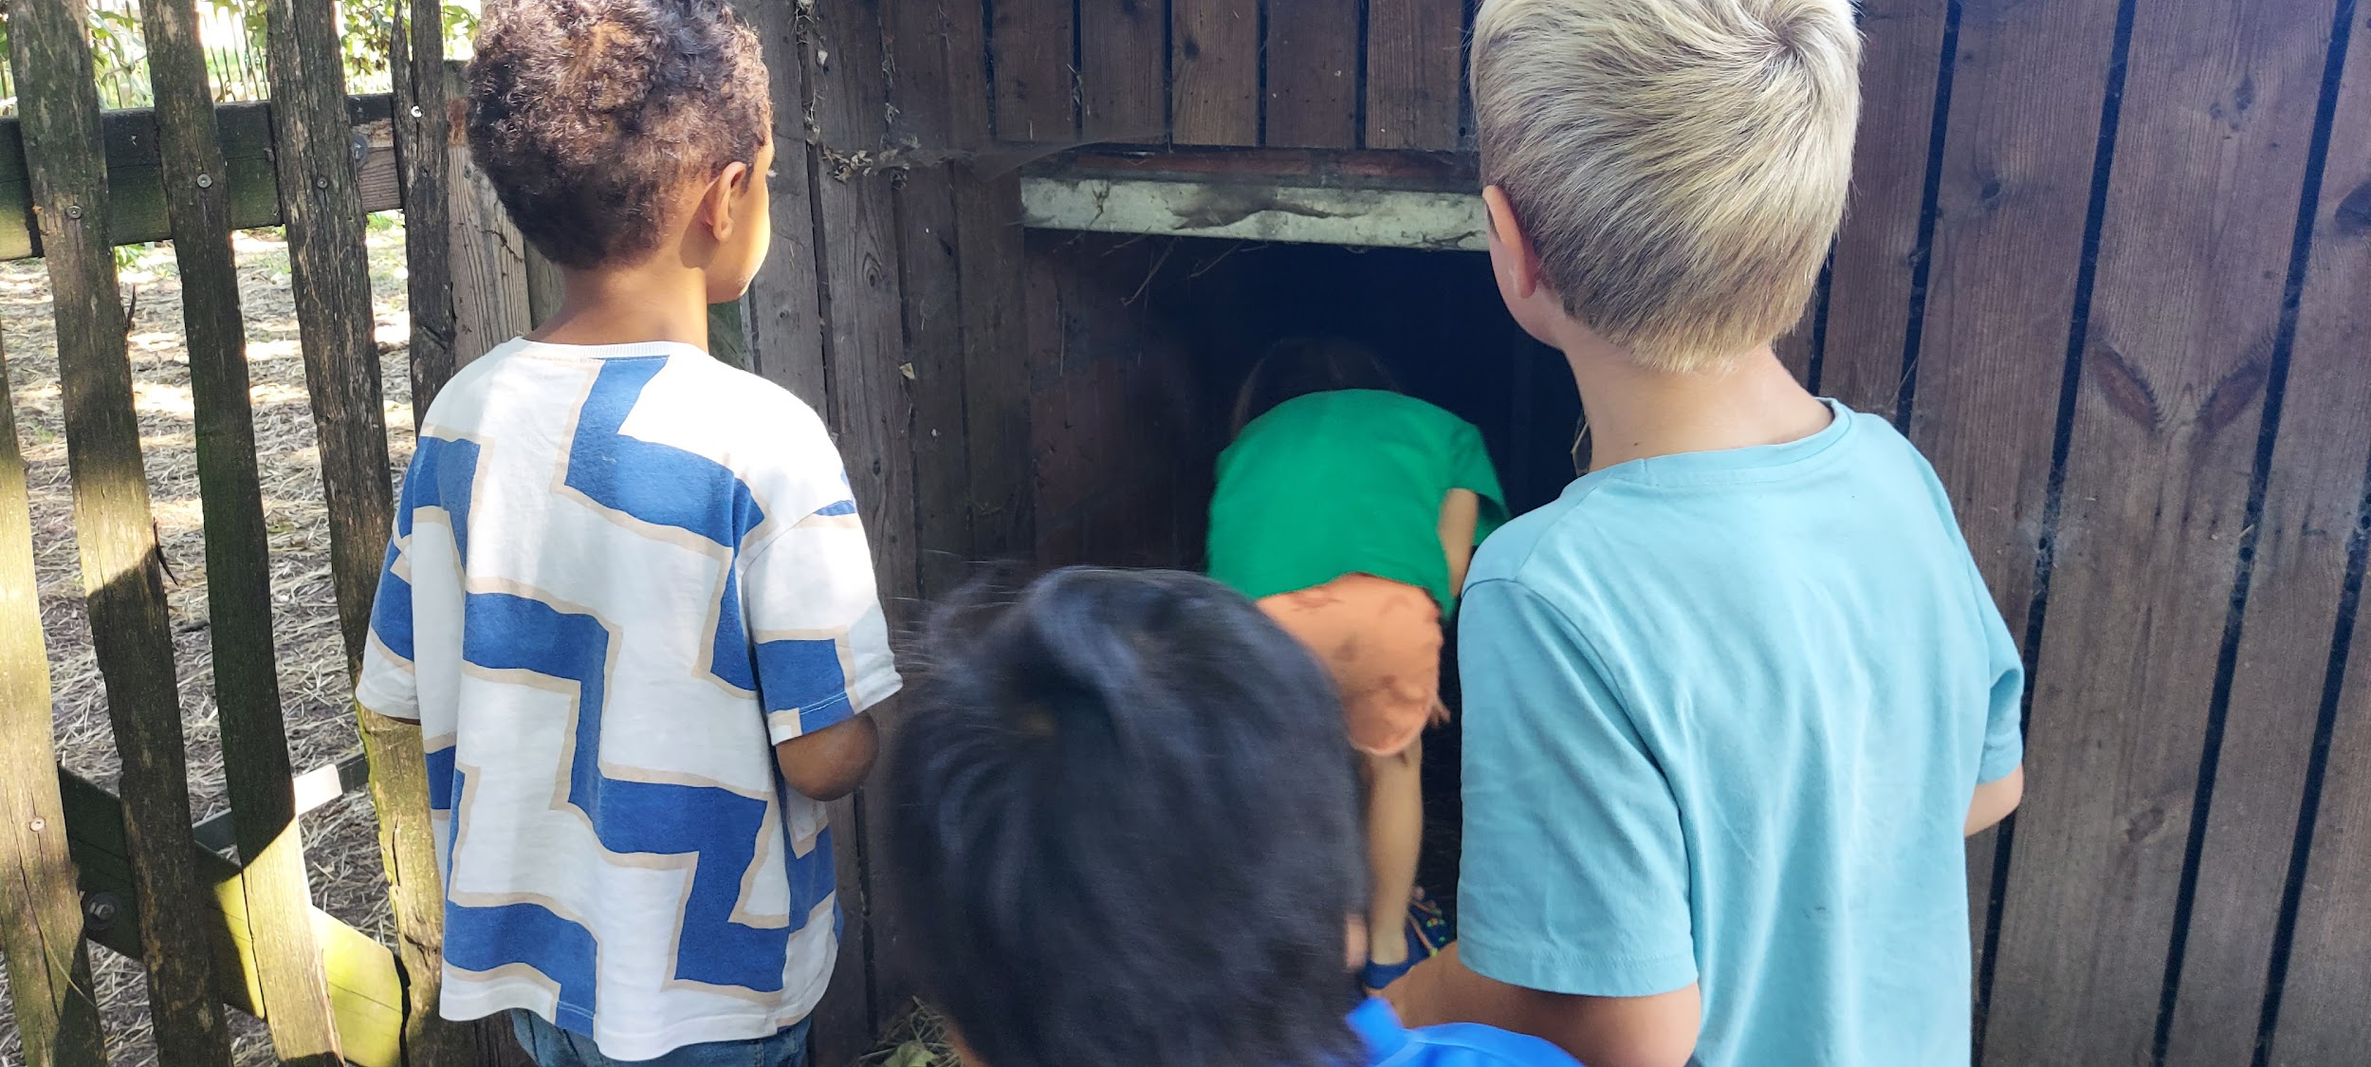
Solution-oriented thinking
'The stepping stone might be in the pigsty’’
'I'm not going in’
'I dare as well’
'I can't see it, it's too dark in here'
Notes:
We searched in the animal park but didn’t found anything. There is one possibility, maybe there is a step stone in the pigsty?

Slide 14
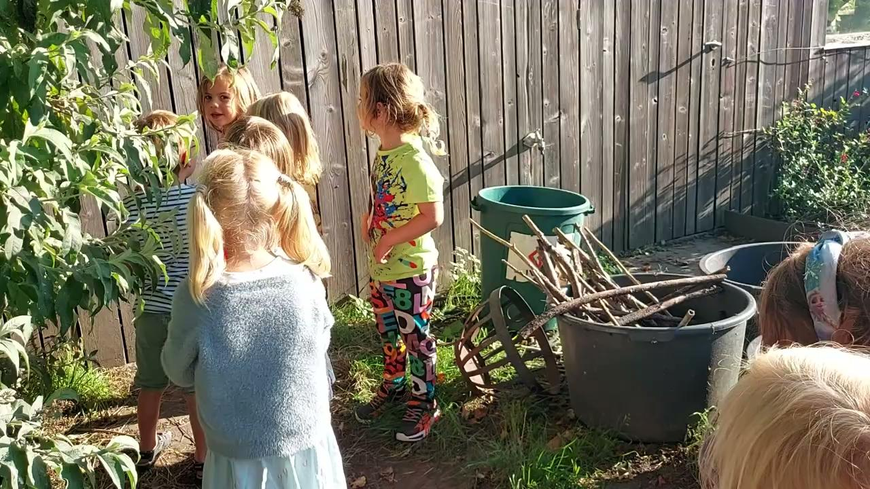
Solution-oriented thinking
VIDEO
'What are you going to do’
'We are going to open the door, then there will be more light'
Notes:
The children spontaneously come up with a solution.

Slide 15
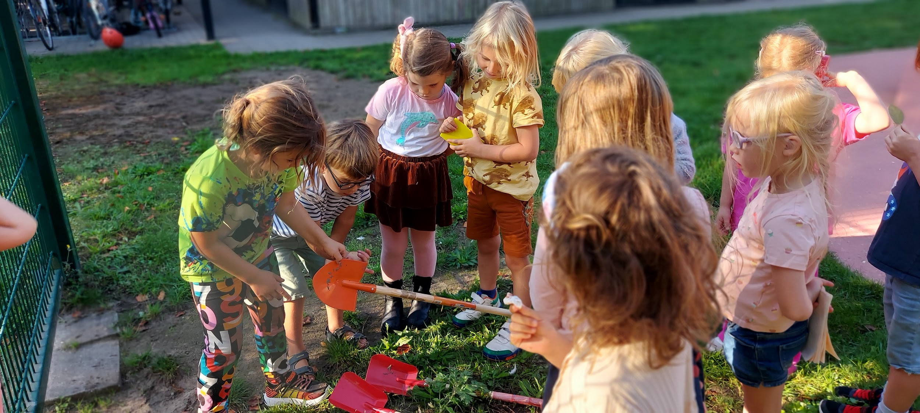
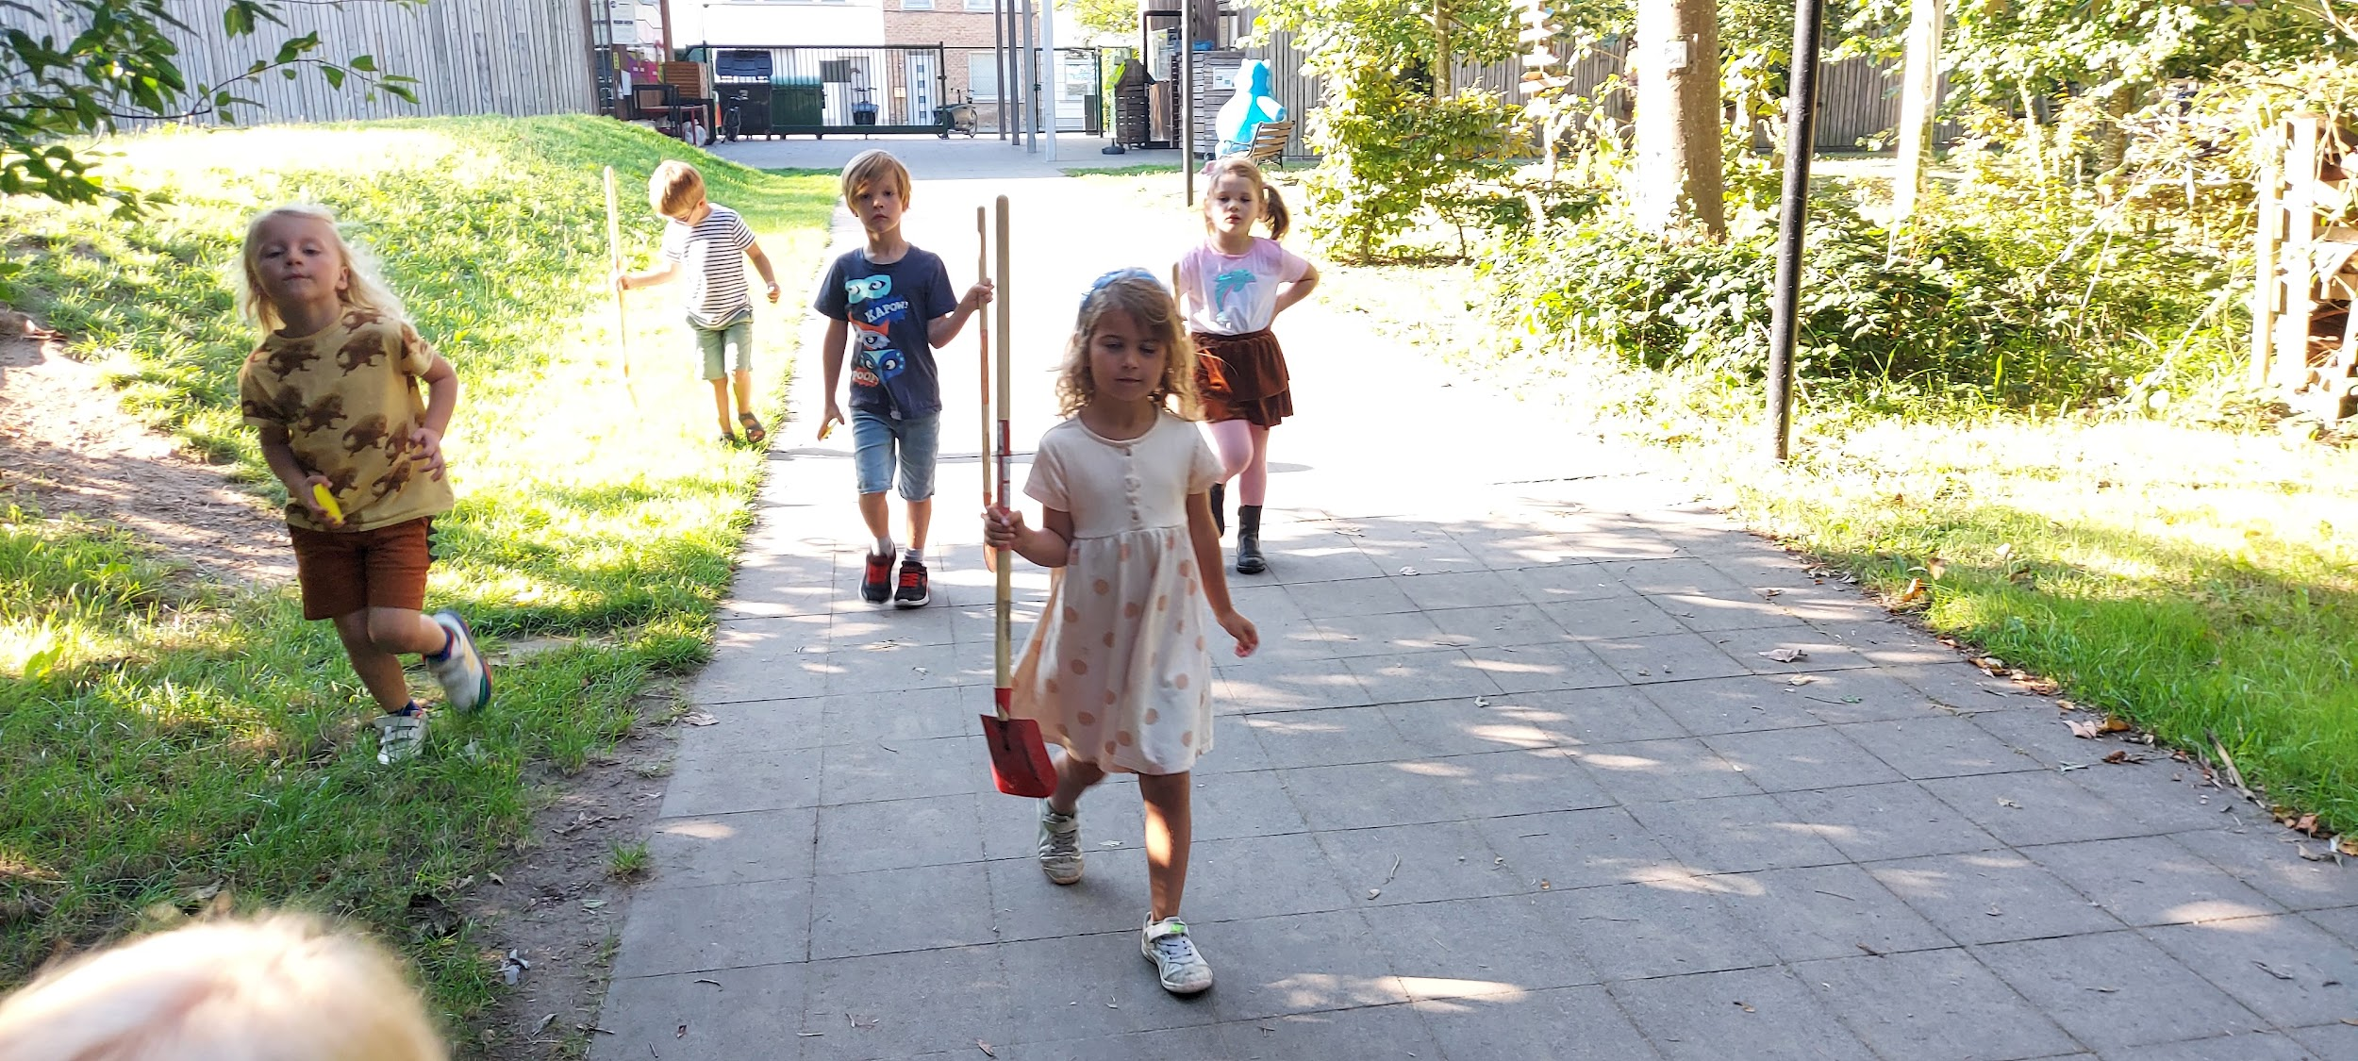
Ability to work safely at risk
technique: discuss why
how to handle the materials

Slide 16
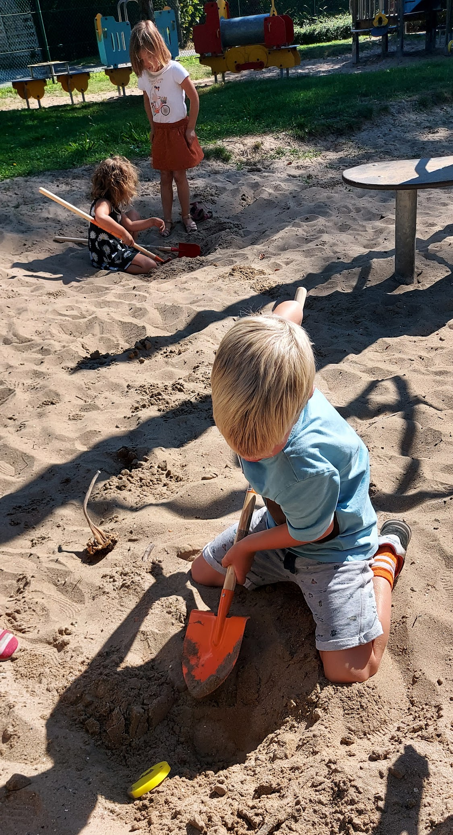
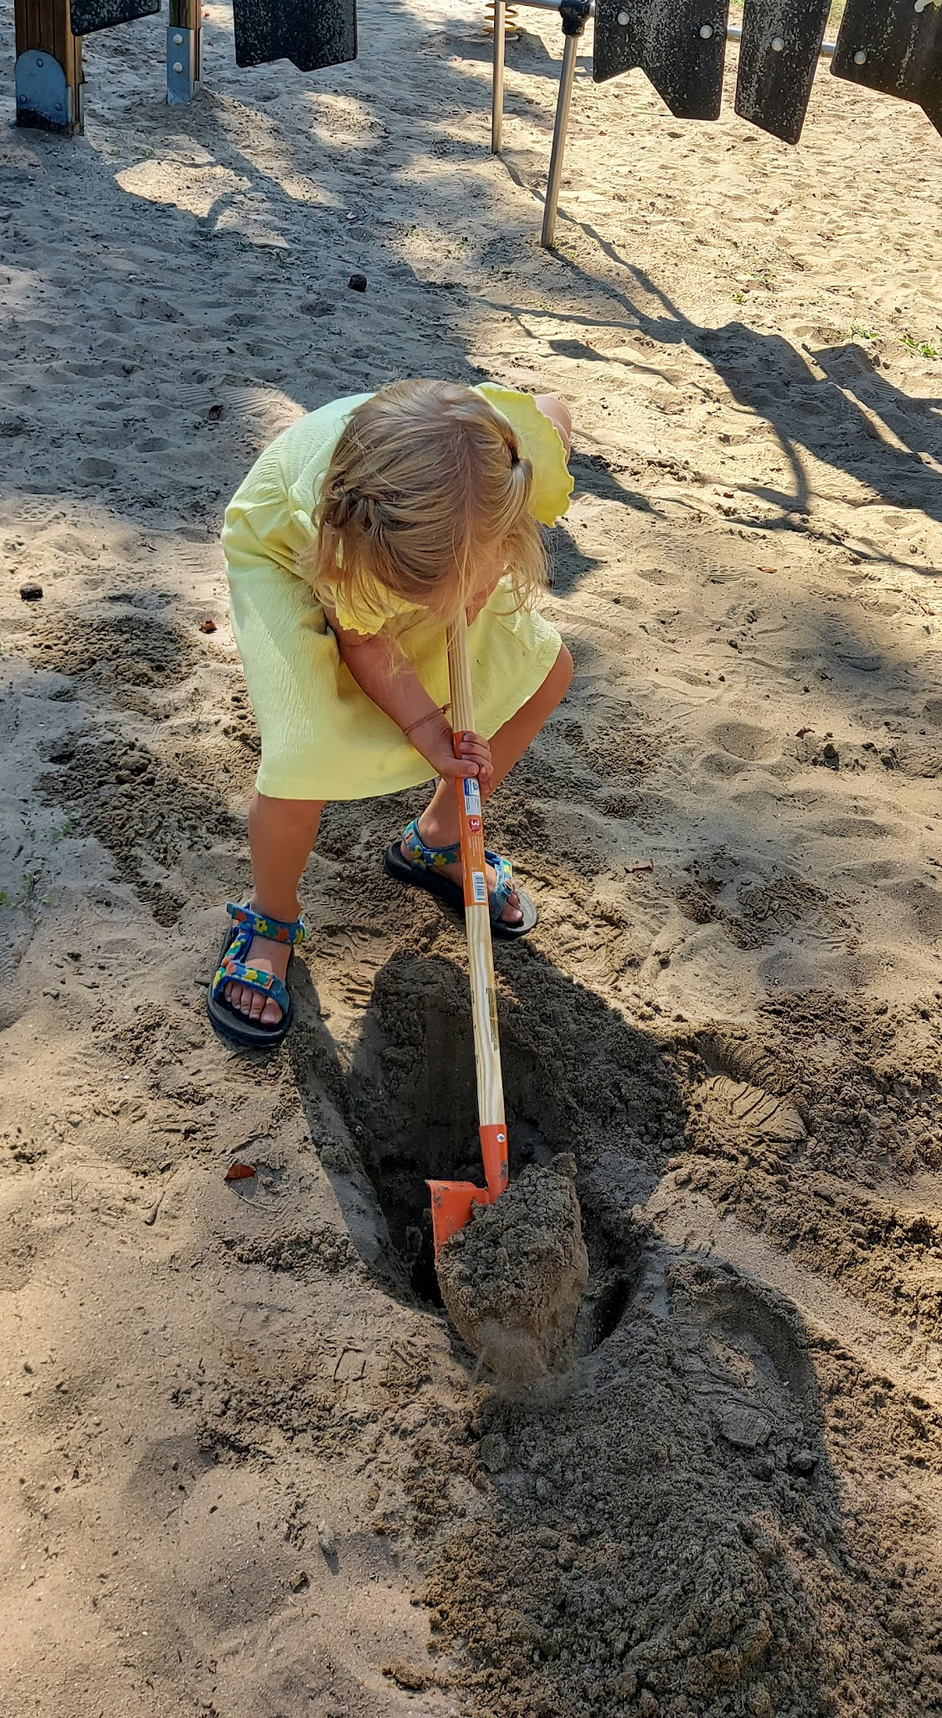
Ability to work safely at risk
Working with metal shovels
In search of the geometric shapes

Slide 17
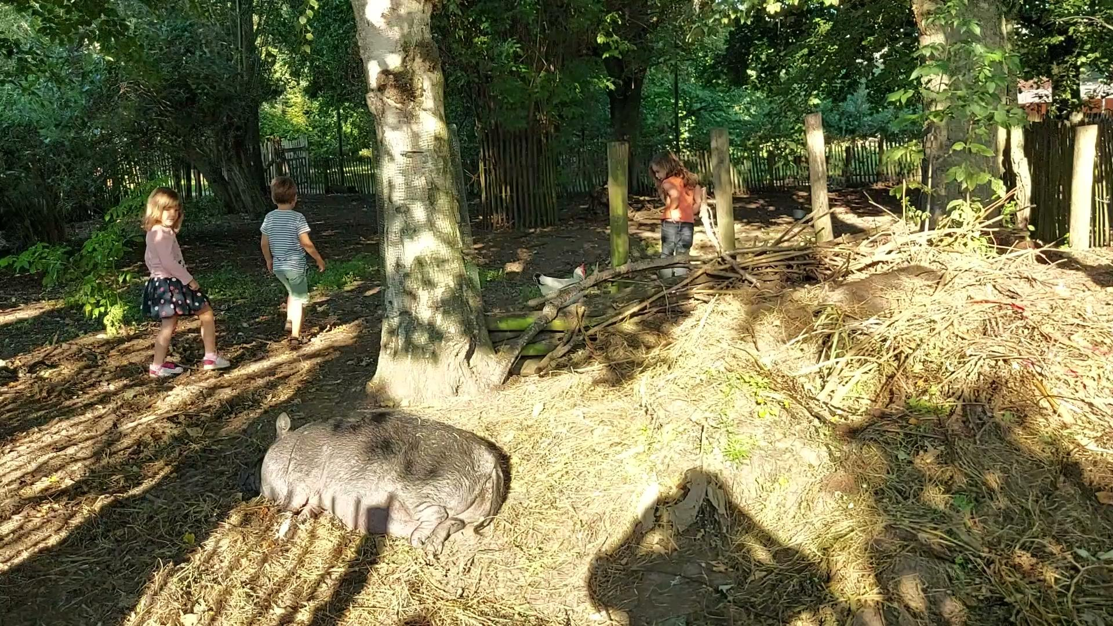
Respect for nature
VIDEO
Quiet, careful ... try, shhh ... then the animals won't startle

Slide 18
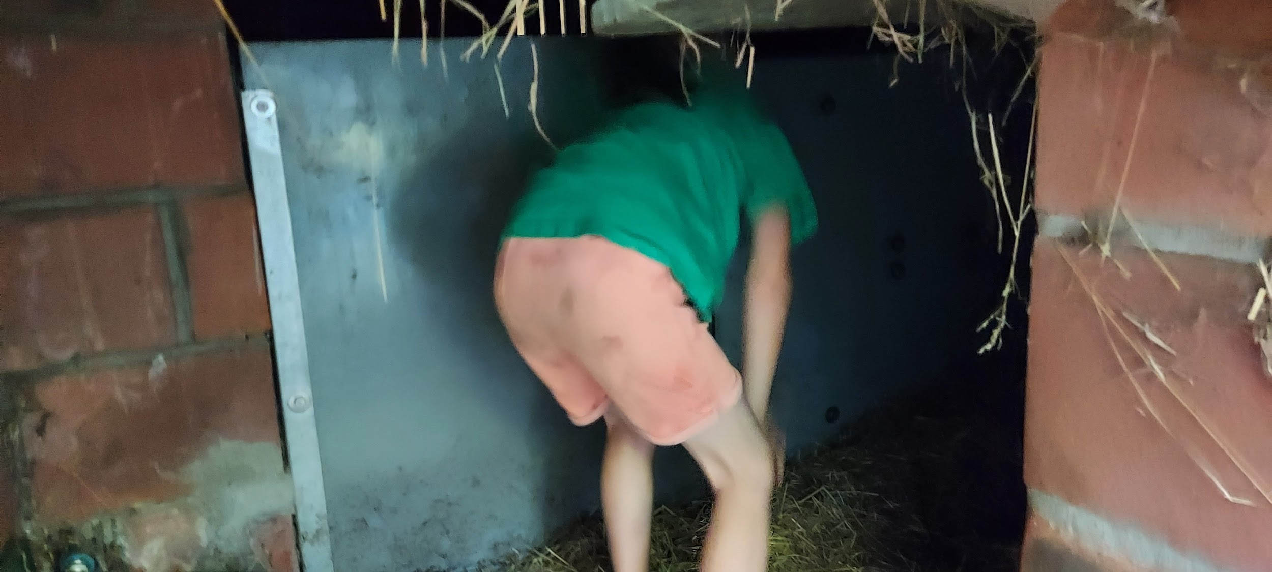
Active participation / challenge
'I don't dare, it's dark and there are cobwebs'

Slide 19
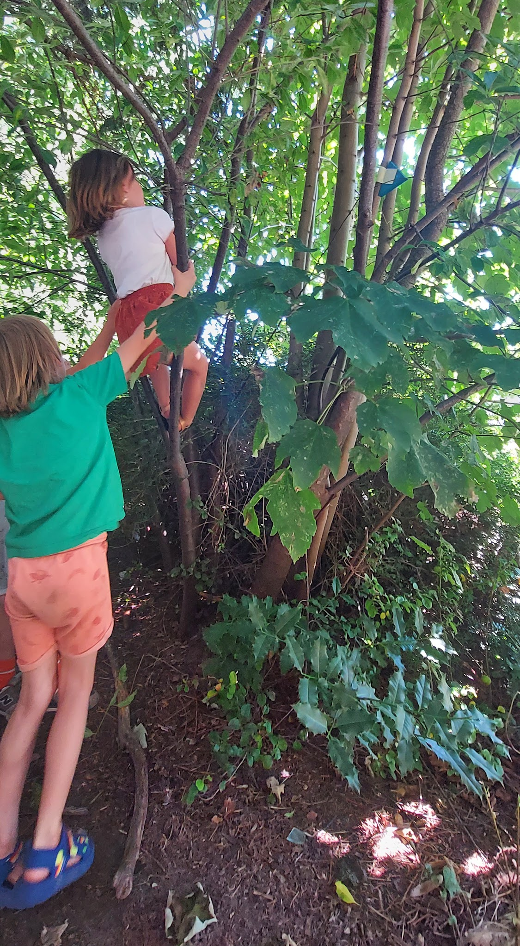
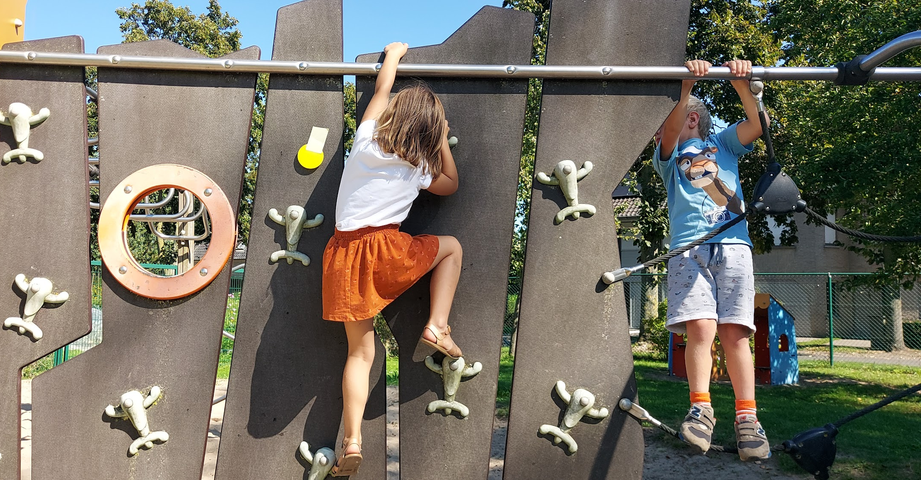
Active participation / challenge

Slide 20
How did the children respond
calm, mostly motivated
honest with themselves and others
they told their feelings
pushed their limits
helpfulness and creative solutions came spontaneously
they were triggered
intense experience
good cooperative work form to create a group bond -> automatically builds trust with each other
Notes:
I chose for the word ‘trust’ because this word is the key. The’re must be trust en also with this activity trust grows.

Slide 21
What do you experience as a companion
Monitoring safety and applying agreements
Temper enthusiasm
Getting to know the children differently and better
Distribute tasks
Creates a bond of trust
Notes:
As a companion you must observe your group so you know the initial situation, than you know how to best organize the activity.

Slide 22
Preparation & Completion
Preparation
Gathering materials and applying them in advance for the search
Make use of what the environment offers saves time in preparation
Completion
Puppet show and outdoor play -> conquer valuables
Notes:
I chose for this image because i want to say by choosing the fastest route, you save time and resume or organize an activity more quickly.

Slide 23
Conclusion
Take time
Beginning of the year
Nice way to teach agreements/limitation/responsibility
Good use of space = saving time
Retake with the gradation of smaller groups, requiring them to carry out activities independently

Slide 24
CIRCLE 1: CONTEXT
Playground, sandpit and climbing material created in collaboration school & city
Large green area with shrubs and trees
Different farm animals at school
Vegetable garden by parents & neighbors

Slide 25
CIRCLE 2: PARTNERS
open minded teachers
open minded parents
innovation
outdoor & risk full play is a supported vision
motivated children

Slide 26
CIRCLE 3: EDUCATIONAL GOALS
Language
> speak
> express emotions
maths
> think in solutions
> geometry
world orientation
> nature
> respect
sport
> dare
> push
boundaries
language en musical education
> puppet show
world orientation
> space
> people
> society
….

