Slide 1
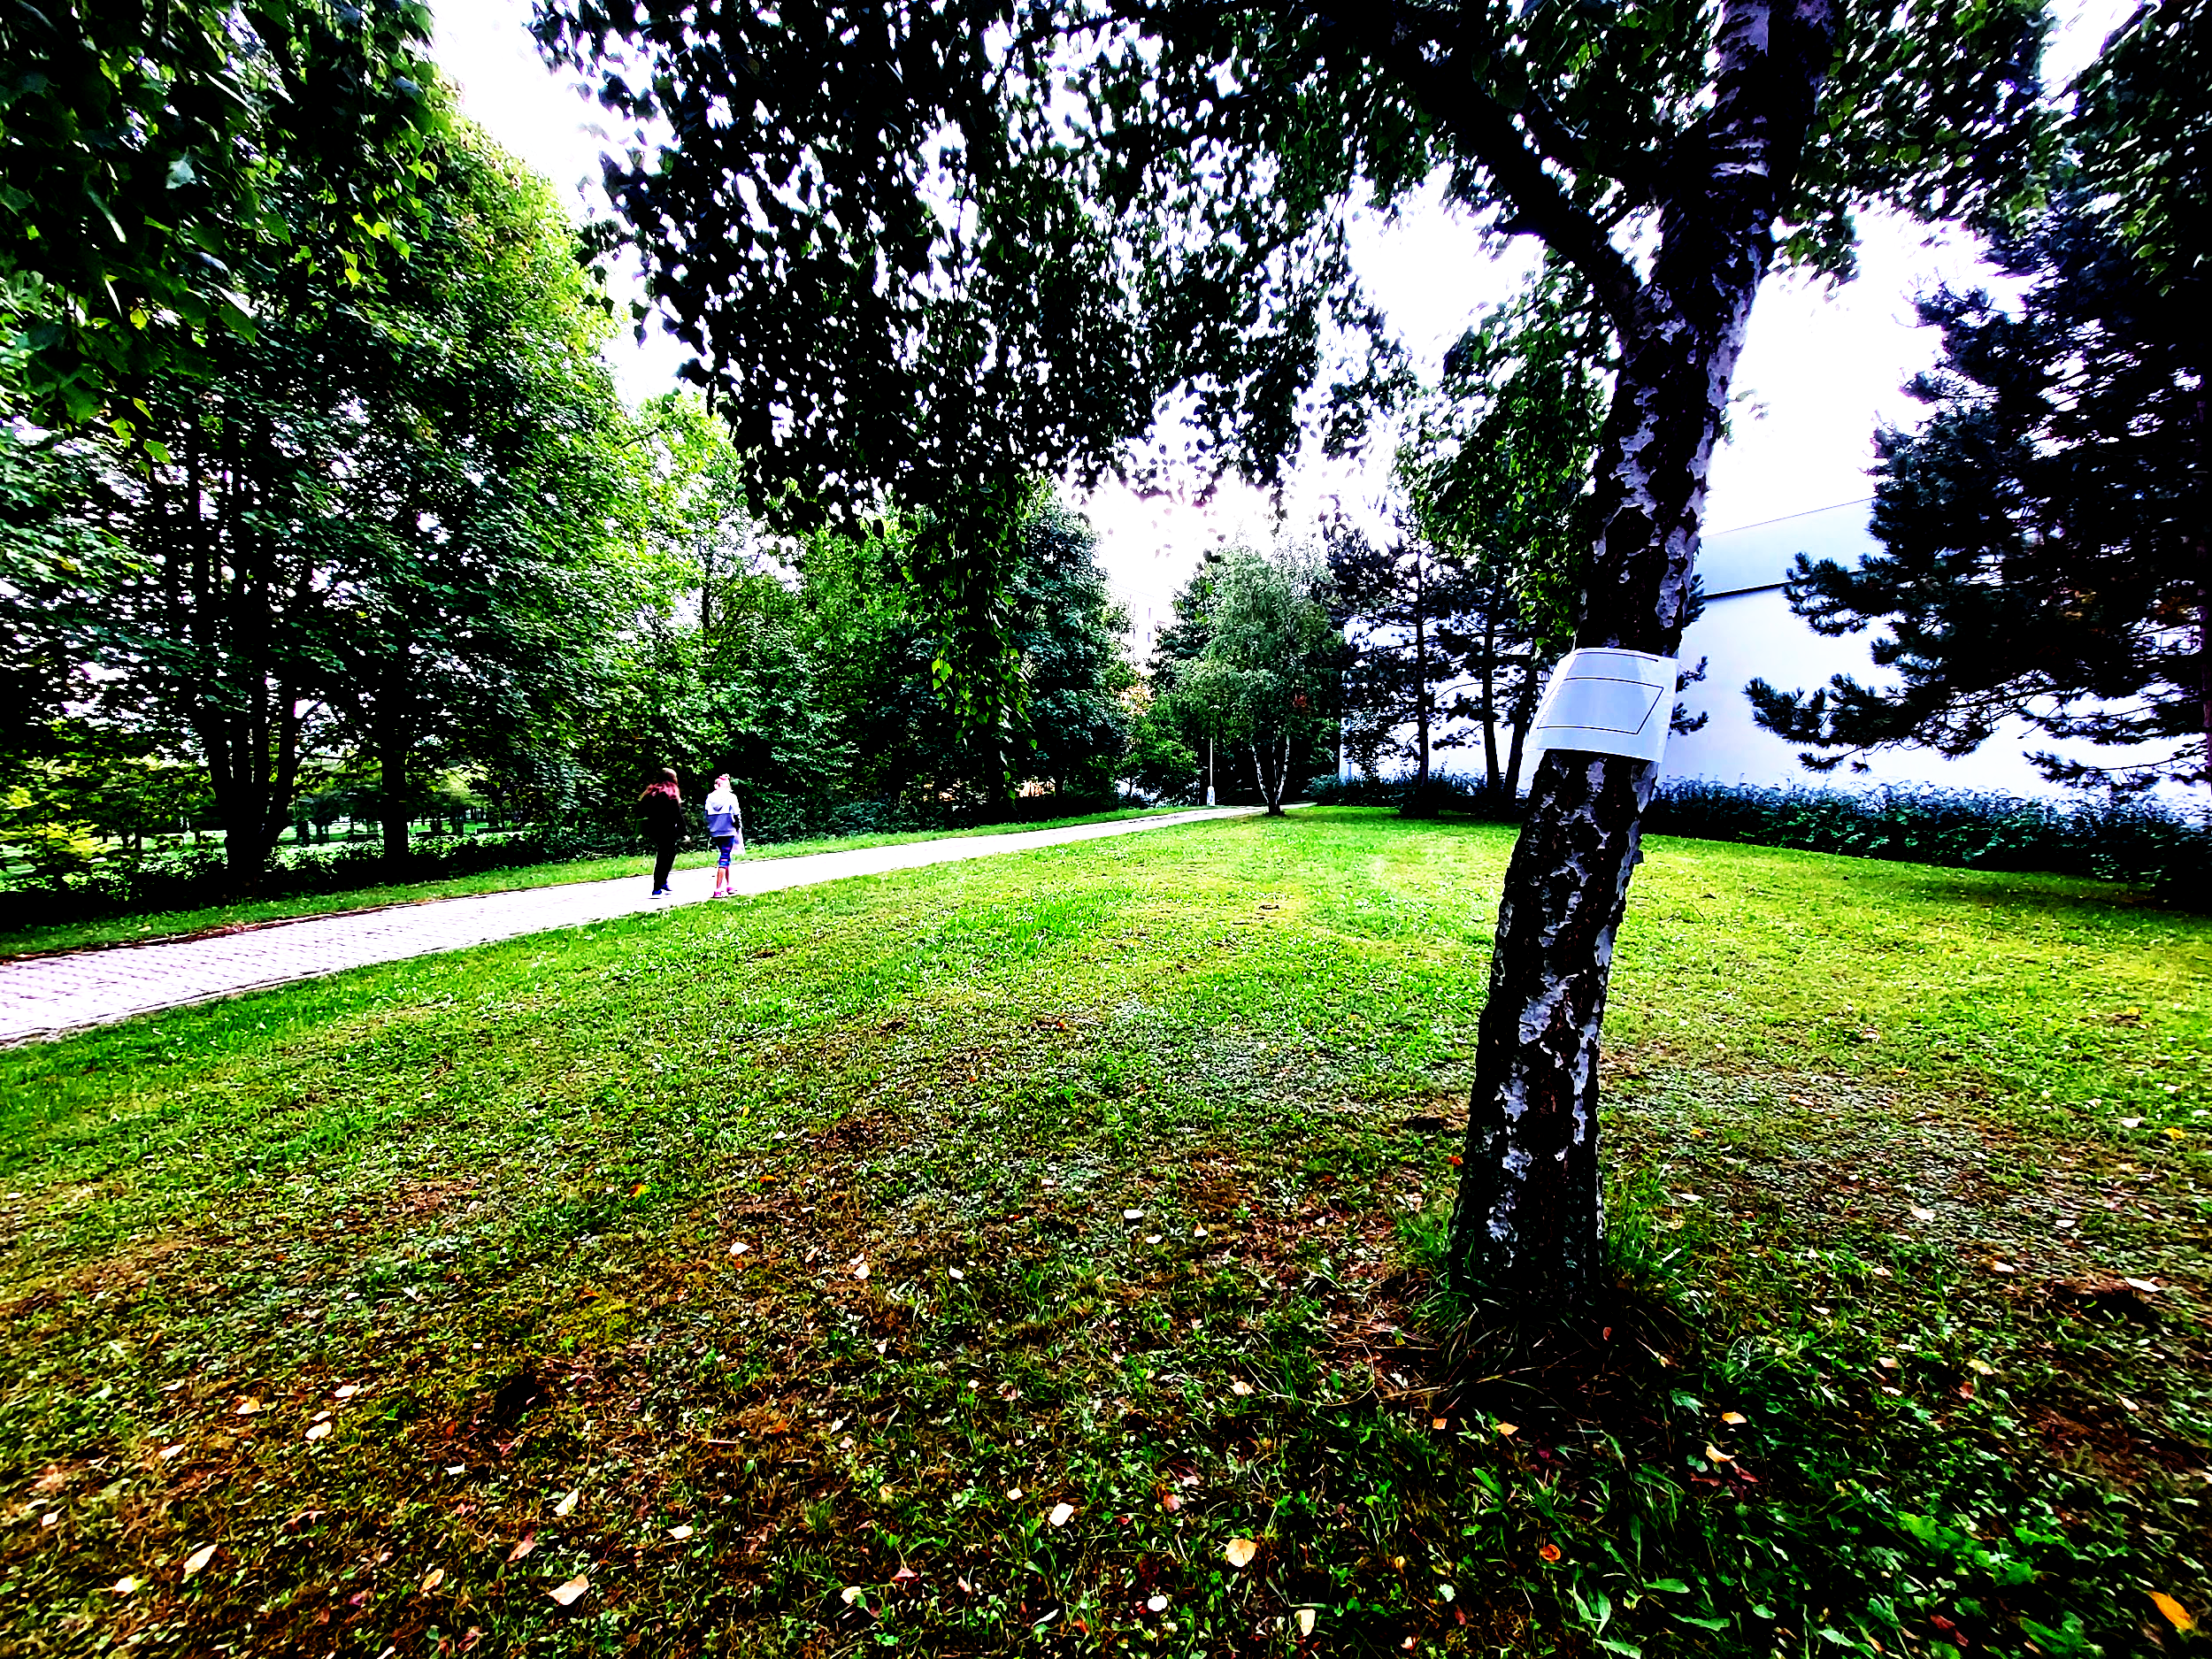
Outdoor activity
group 1
Orienteering and geometric shapes

Slide 2
WHAT?
Orienteering and geometric shapes
WHO?
5th-grade students - 10-11 years old

Slide 3
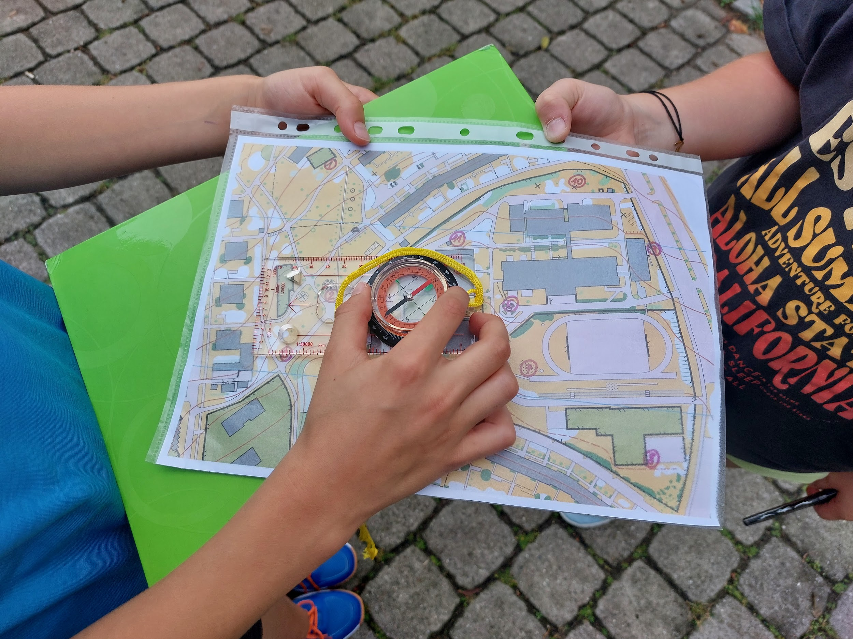
HOW?
Introduction - dividing students into pairs, preparing aids
Moving to a park near the school
Explanation of the rules of the activity
Familiarization with the map, orientation using a compass and objects on the map
Start/finish location markings

Slide 4
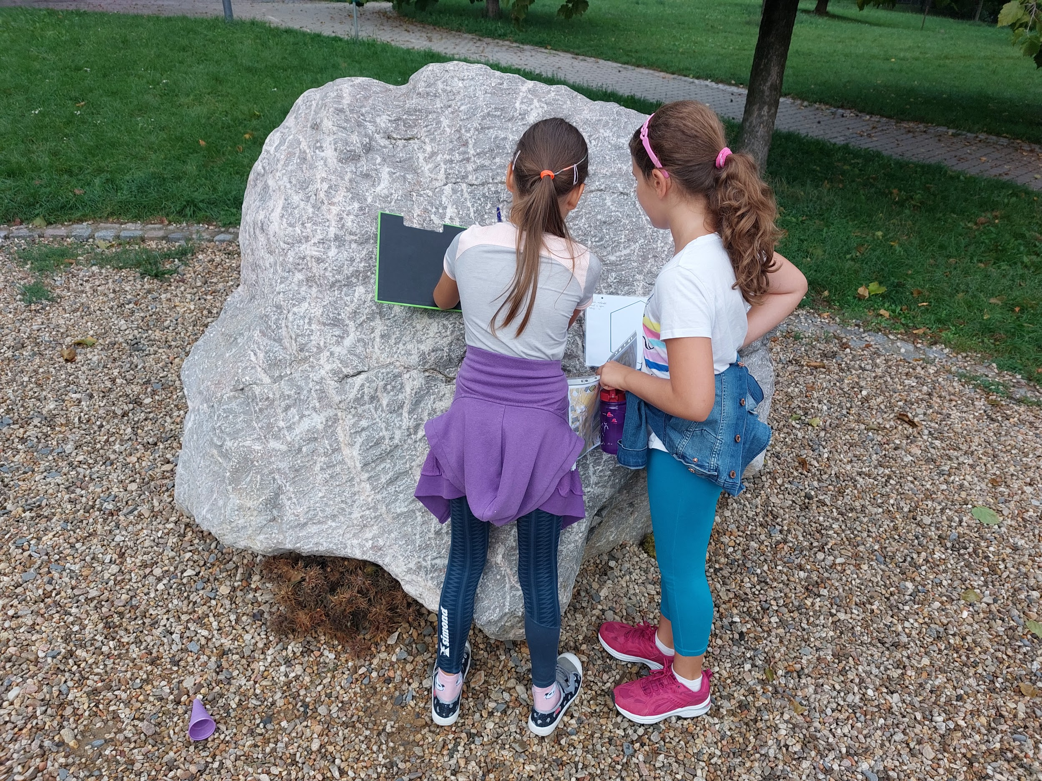
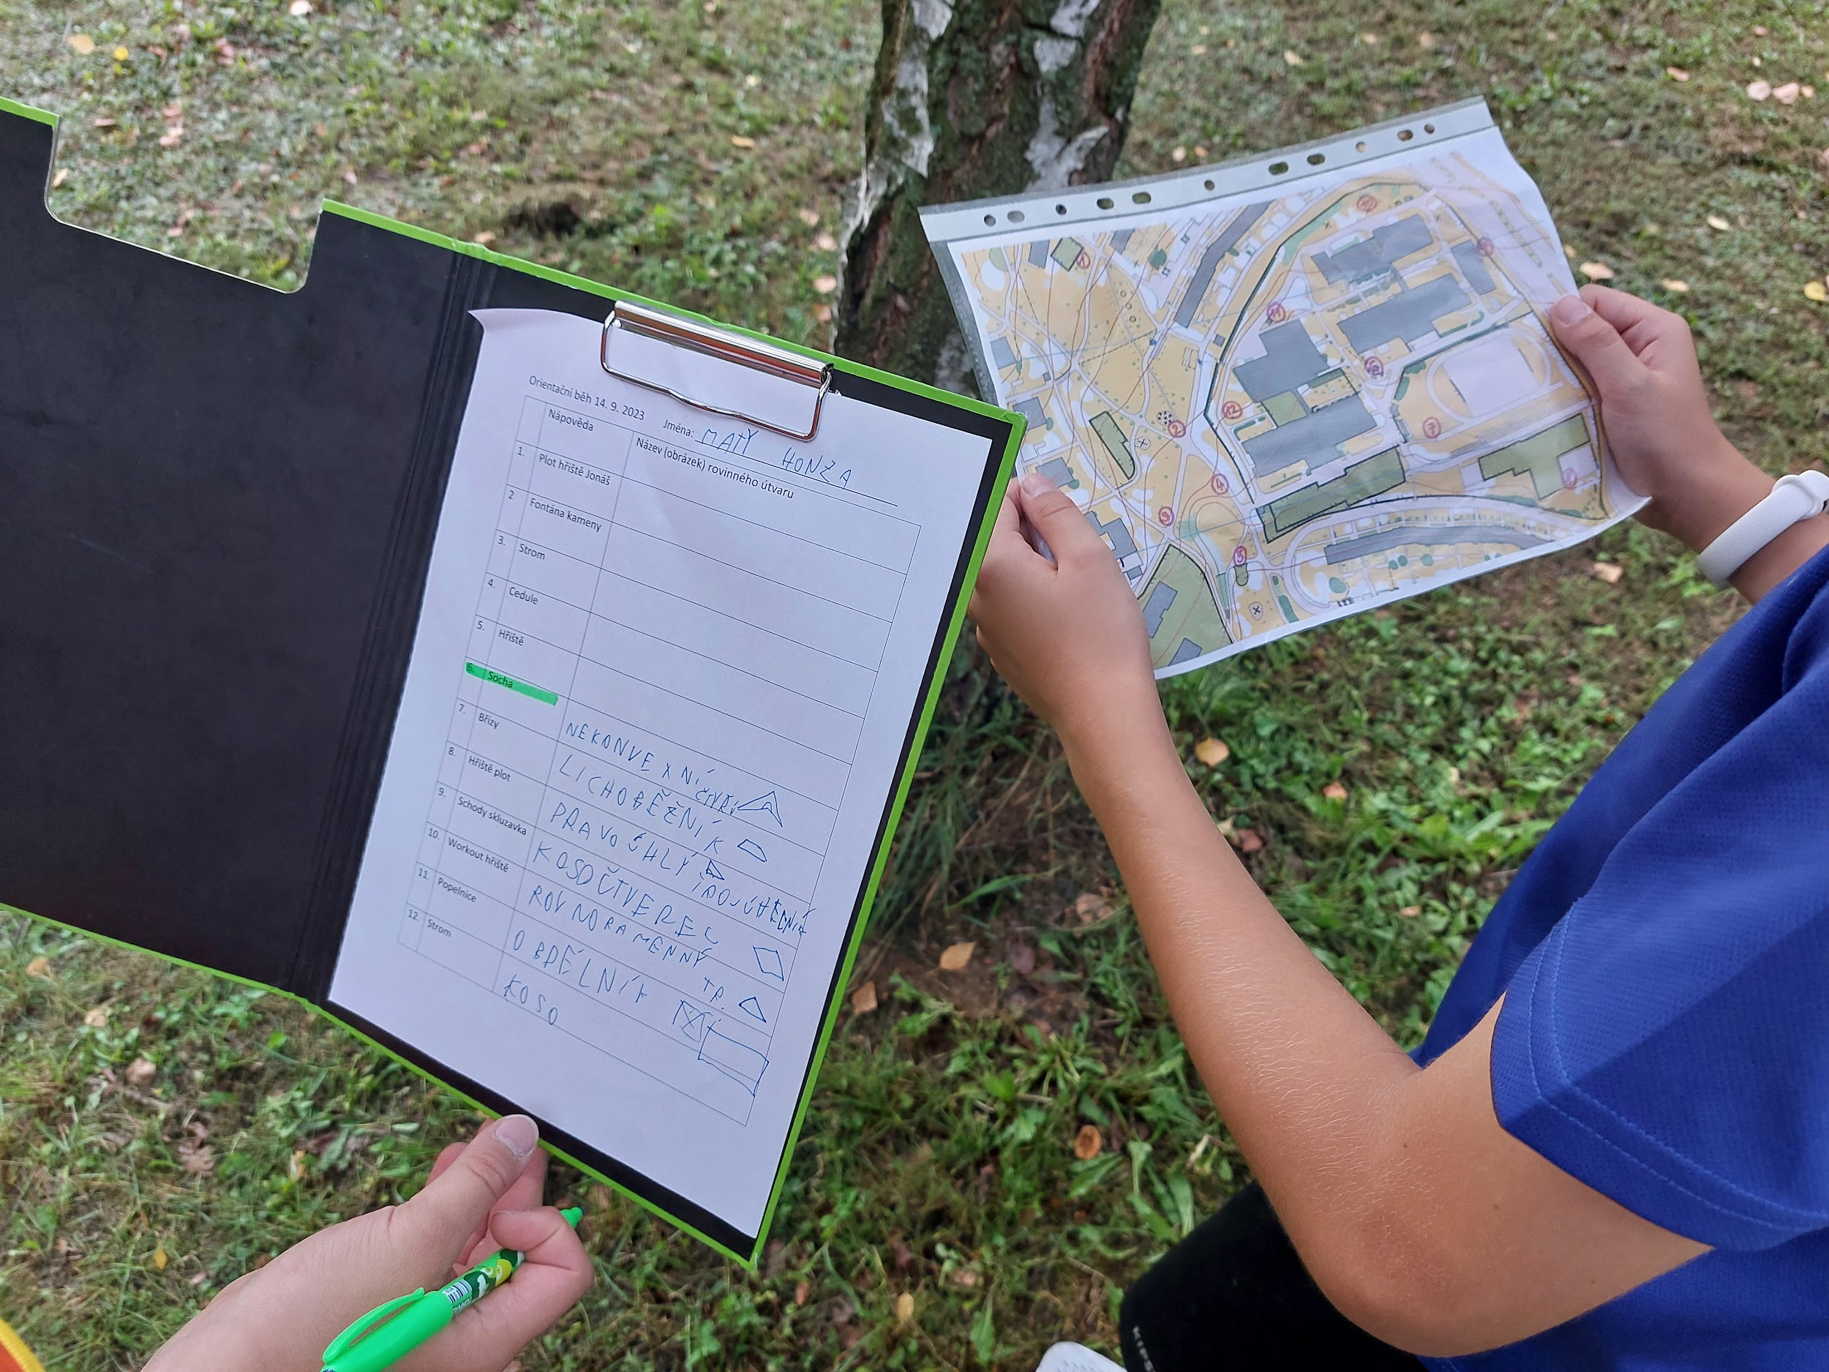
HOW?
6. The children had the task of going around a total of 12 locations marked on the map. At each station they found a picture of a geometric shape. They named it and marked it in the worksheet.

Slide 5
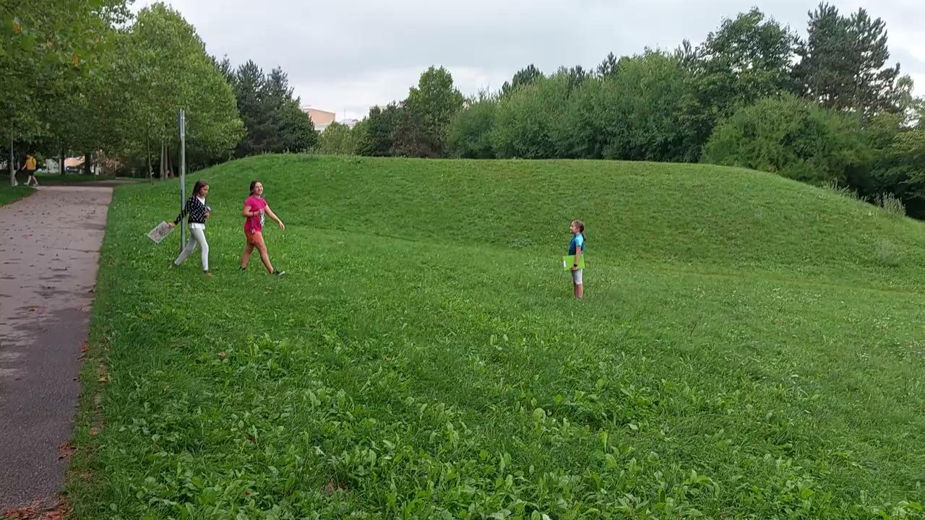

Slide 6
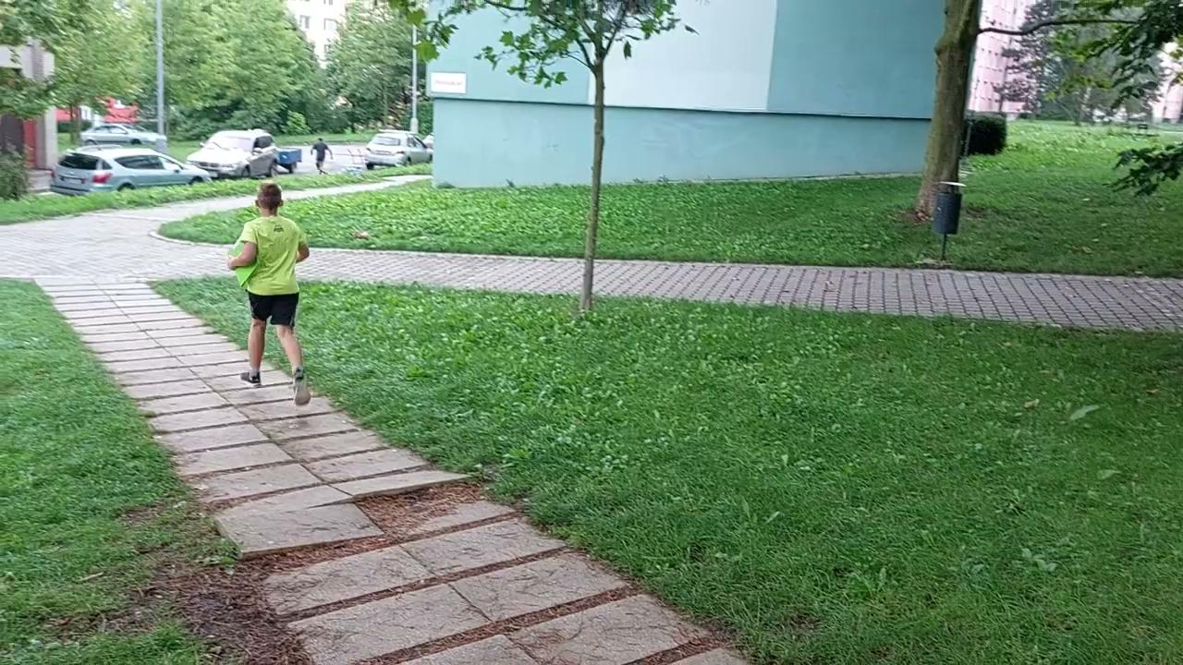

Slide 7
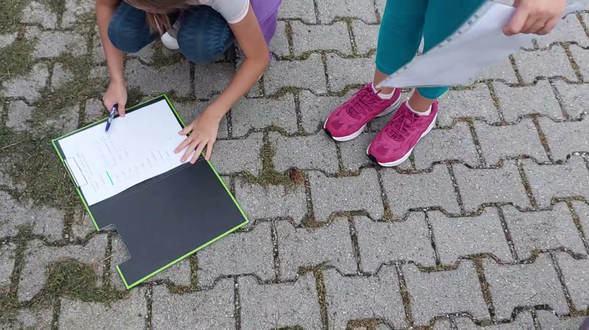

Slide 8
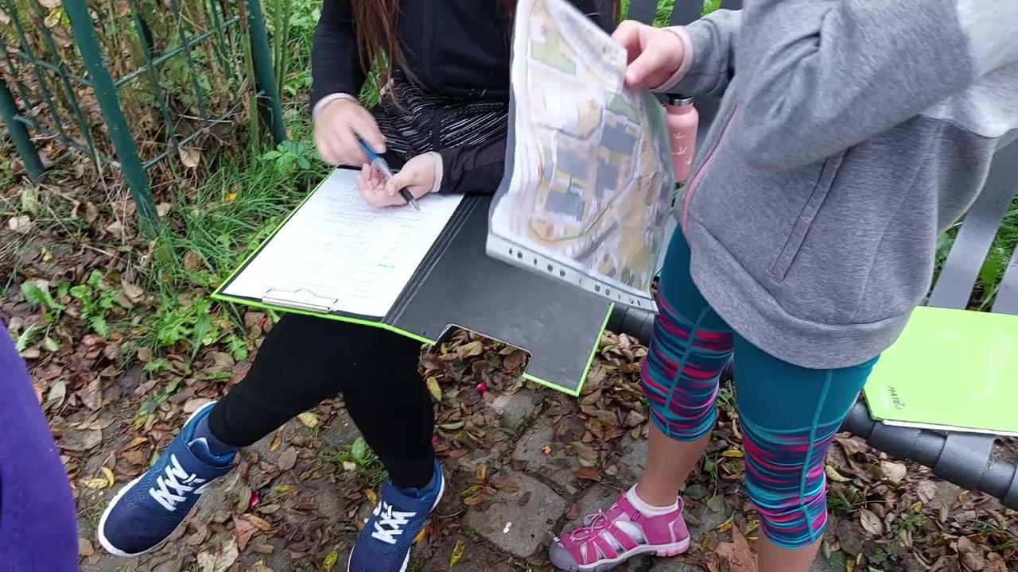
HOW?
7. After finding all the geometric shapes, the children returned to the start. With the help of the teacher, they checked the correctness of naming geometric shapes.

Slide 9
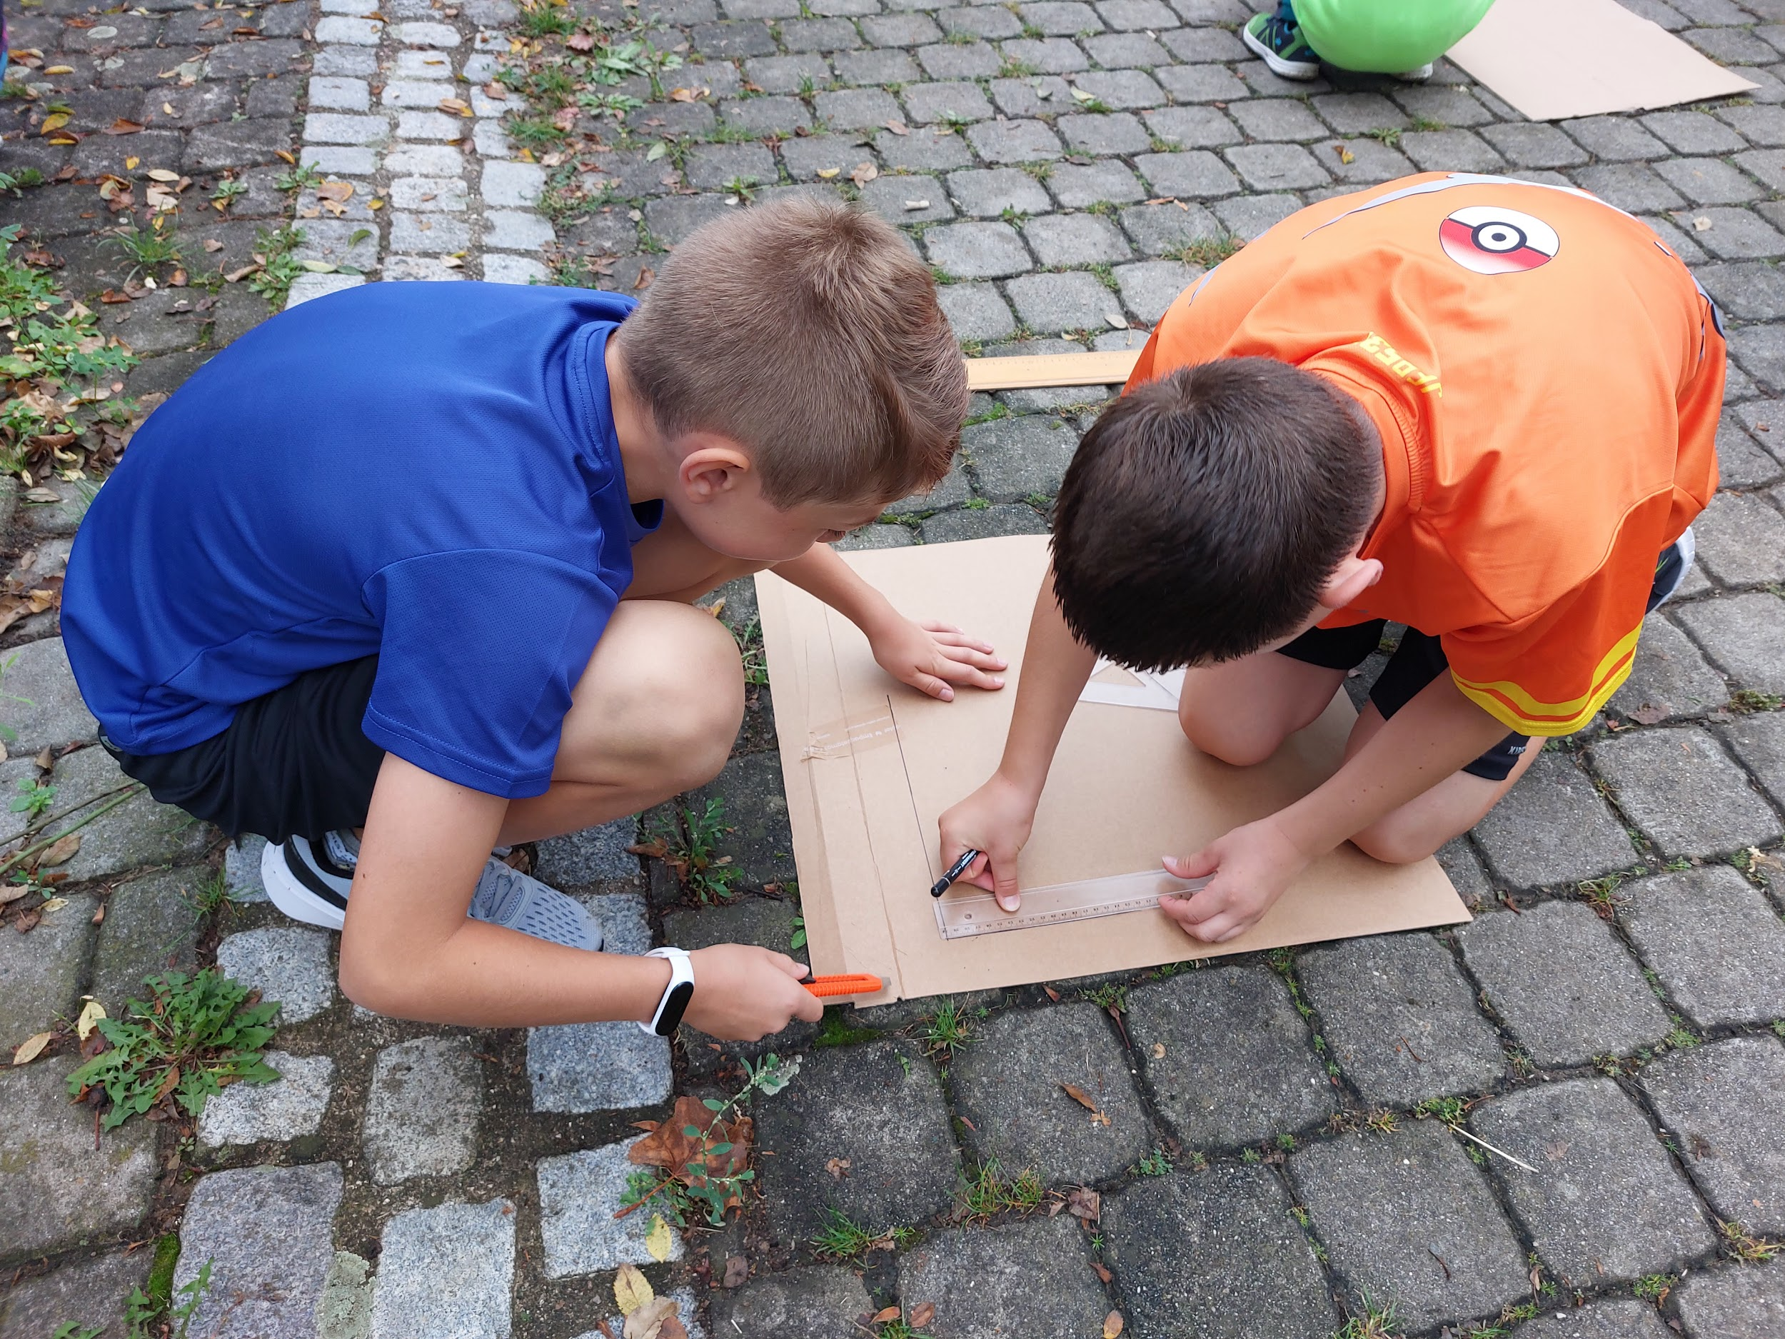
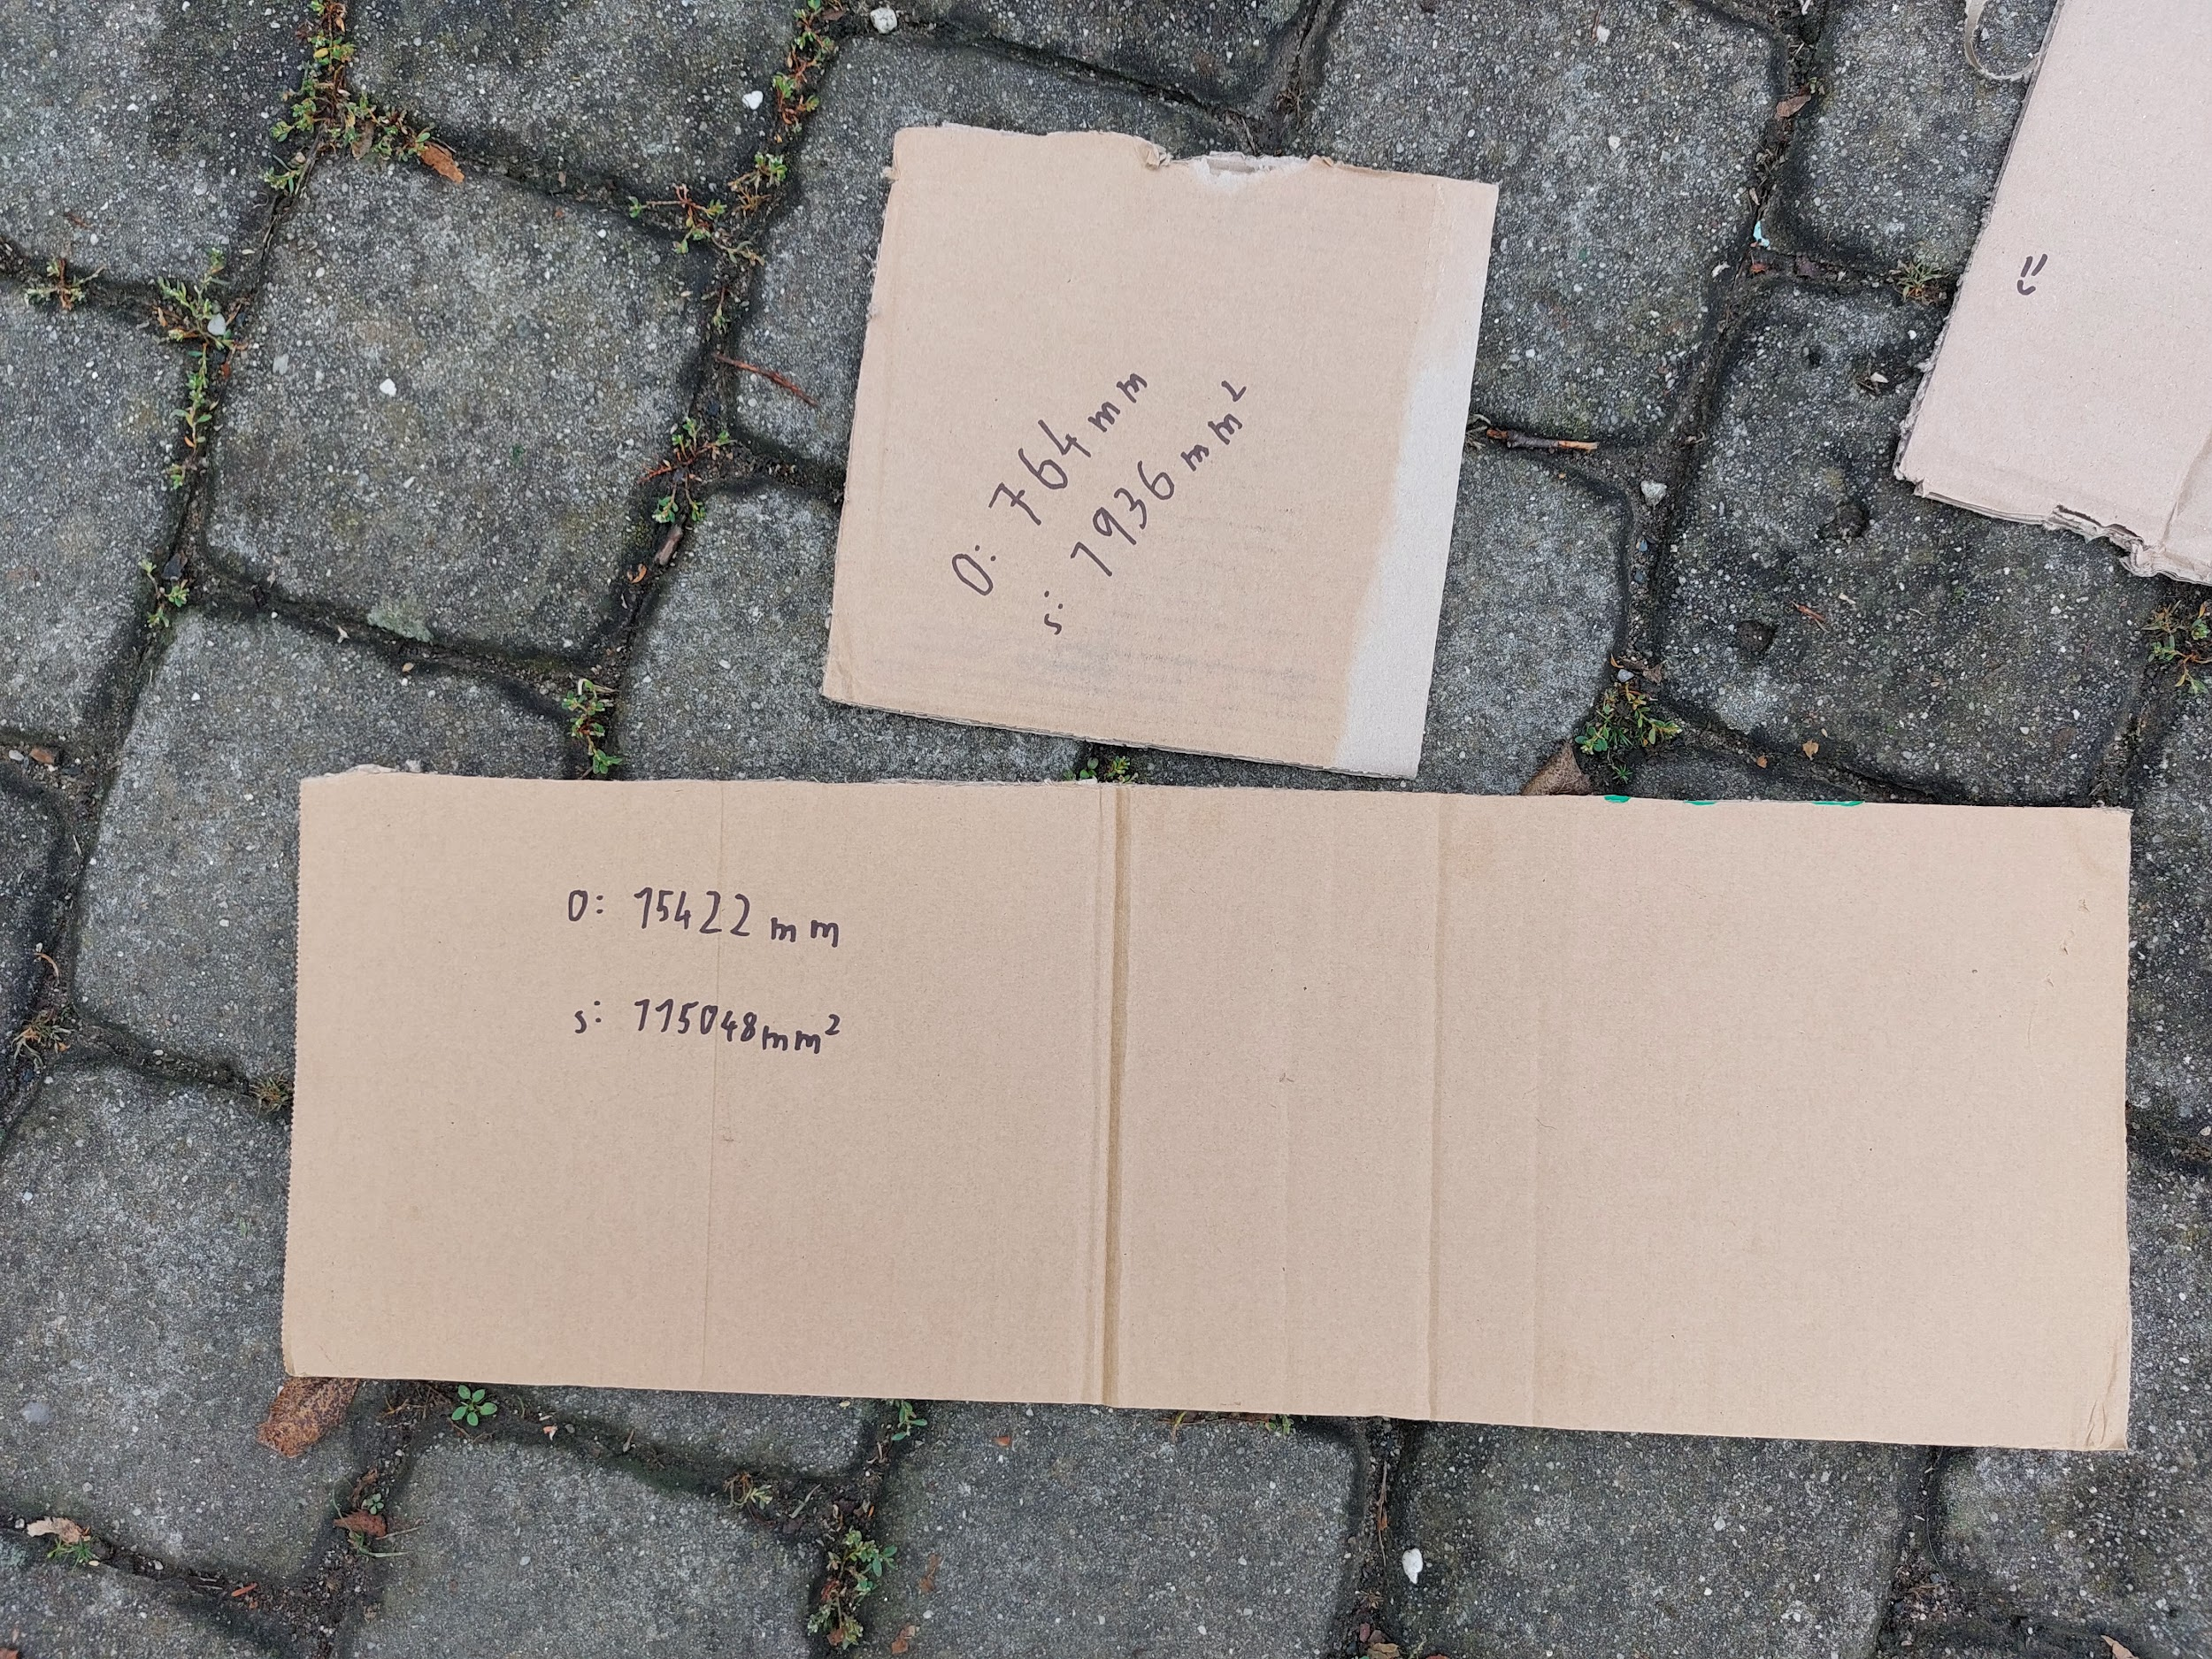
HOW?
8. The pupils made a square and a rectangle out of cardboard. They measured, drew and cut. Then they calculated the perimeter and content of these geometric shapes and wrote them down on the finished product.

Slide 10
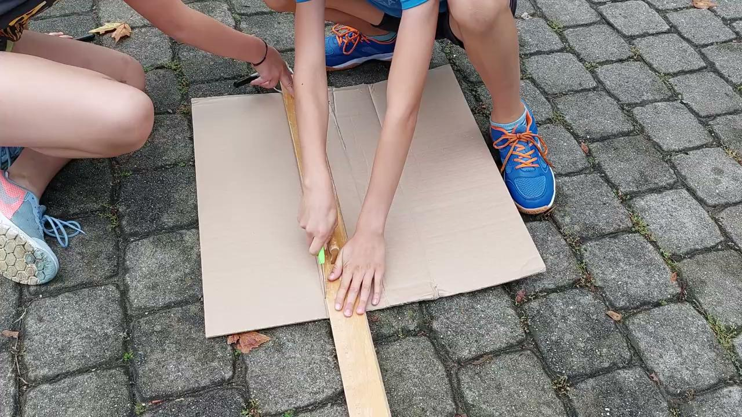
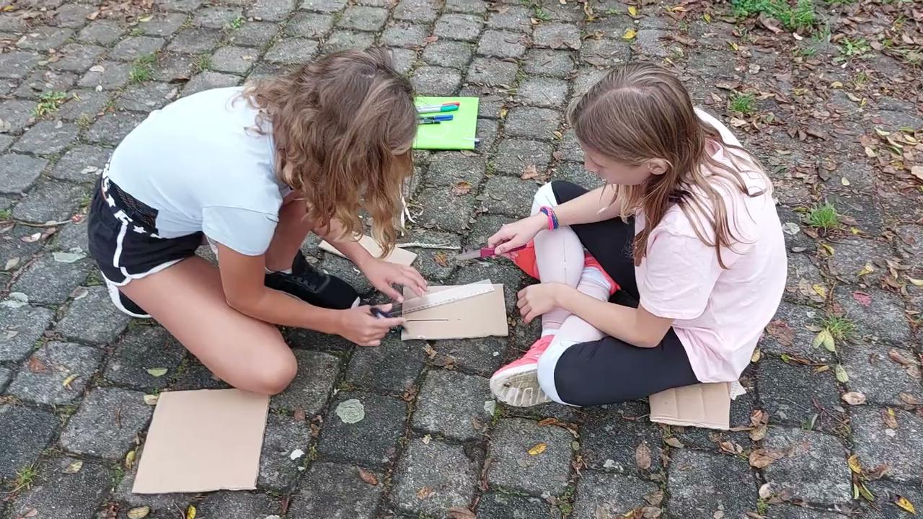
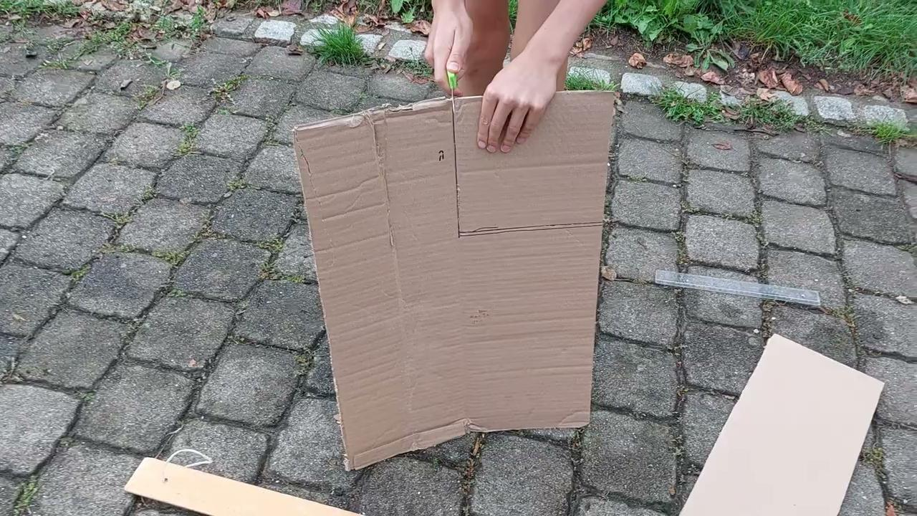
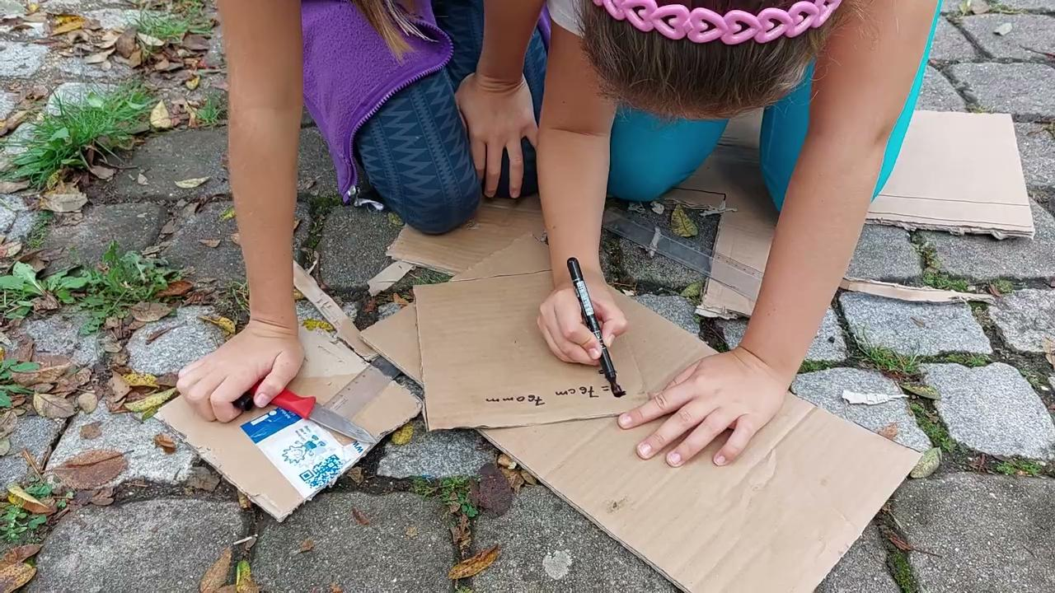

Slide 11
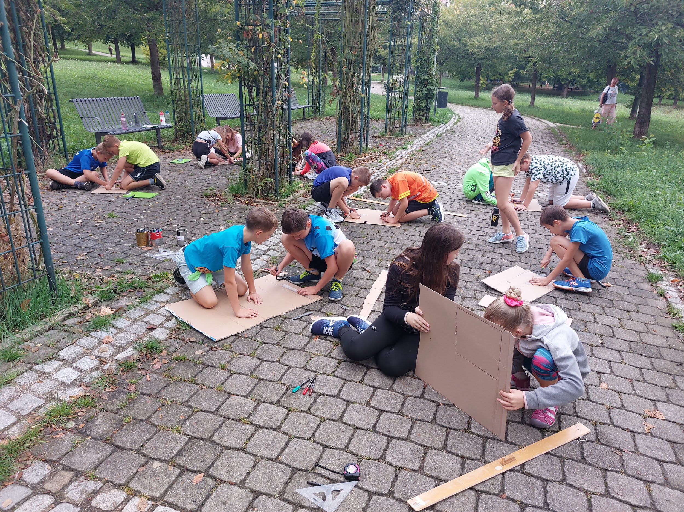
HOW?
9. In the circle, the children presented their creations, described the method of work. We have summarized outdoor education. The children commented on what interested them in the lesson, what they have learned.

Slide 12
LEARNING GOALS
Pupils orient themselves on the map and look for marked objects in the field.
Pupils name geometric shapes.
Pupils cut out a rectangle and a square from cardboard, calculate their perimeter and content.
Pupils practice cooperation, communication and problem solving skills in smaller groups.

Slide 13
CONTEXT
Settings: The lesson took place in a park near the school and partly in the school grounds.
Materials/infrastructure: Access to the park, cards with pictures of geometric shapes, maps, compasses, worksheets, pads, pens, cardboard, knives, folding knives, markers, rulers.
Challenges and opportunities: The biggest challenge was to face the fact that pupils can get lost or injured during the orienteering (while running, then working with sharp tools). Pupils were given the opportunity to practice the skill of orientation in a larger area than they were used to.

Slide 14
PARTNERS
Teacher: The teacher's role was to manage the students' activities, support them, provide advice and help, encourage students to cooperate and complete tasks, provide feedback.
Pupils: The pupils should actively participate, collaborate, and communicate with each other, as well as follow the instructions and safety guidelines provided by the teacher.
School team: The school team can provide support and exchange experiences related to organizing outdoor activities and integrating hands-on experiences into the curriculum.
Parents: Parents can be informed about the activity and its objectives to encourage their support and involvement.

Slide 15
RISKY AND PLAY?
Undoubtedly, the risk was that the students got out of sight of the teachers and could get lost or injured (falling) during the orienteering.
Another risk was the danger of working with sharp tools when the children were carving geometric shapes.

Slide 16
GENERAL FEEDBACK/REFLECTION
What worked best:
Although some children occasionally got lost during the orienteering run, they all managed the task without major difficulties
The children chose the pace of the run according to their possibilities.
The mutual cooperation of the children and their communication with each other was perfect.

Slide 17
GENERAL FEEDBACK/REFLECTION
What worked best:
The children were so excited about carving geometric shapes that they worked beyond the scope of the assignment and created other objects and wanted to keep the cardboard scraps for further creations. :-)
All rated outdoor learning as fun.

